Slide 1
CP 311
OOP in PHP
By: Ramadhani Mbaga
Mobile: 0784291734
Email: rmmohamedi@gmail.com

Slide 2
Why OOP
Most of Companies want OOP, not Procedural
Support group work
Easy to re-use code
Codes are better organized
Good in developing large applications
OOP is faster and easier to execute

Slide 3
Pre-requisites
Been familiar with Procedural PHP programming skills
A web server (ideally on your local machine)
A current version of PHP
A code/text editor of your choice

Slide 4
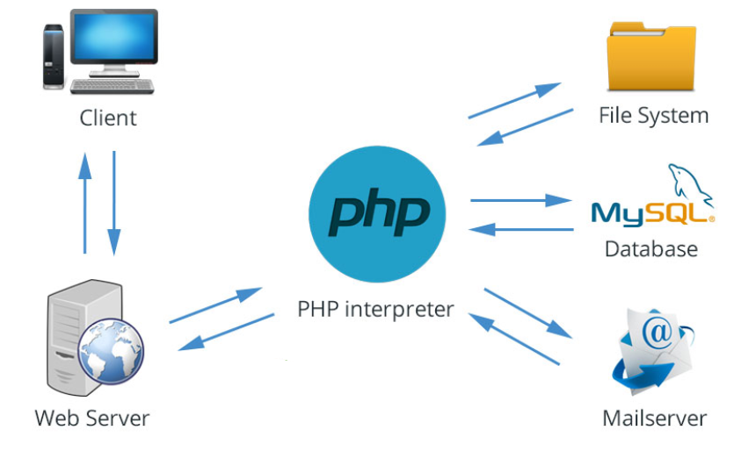
PHP

Slide 5
Procedural VS OOP
Three (3) important tasks in PHP
  Database connectivity and manipulations.
  Handling data submitted by users
  Render Database data to users

Slide 6
Procedural VS OOP
Procedural programming is about writing procedures or functions that perform operations on the data
Object-oriented programming is about creating objects that contain both data and functions.

Slide 7
Procedural VS OOP (ctnd…..)
Procedural Object Oriented
Controller
……………..
…………….
……………..
<?php
Controller
……………..
… ………….
………… ….
Model
……………..
… …………..
………………
View
………………
……………..
?>
?>
<?php
Controller
……………..
Model
……………..
View
………………
?>
Model
……………..
…………….
……………..
View
……………..
…………….
……………..

Slide 8
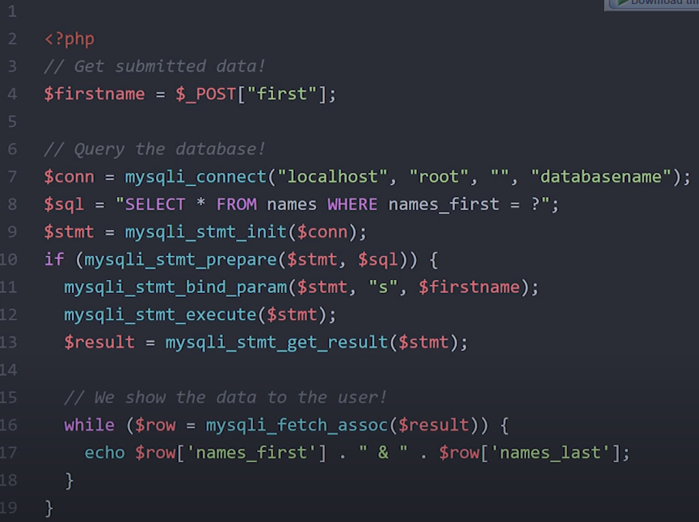
Procedural VS OOP (ctnd)

Slide 9
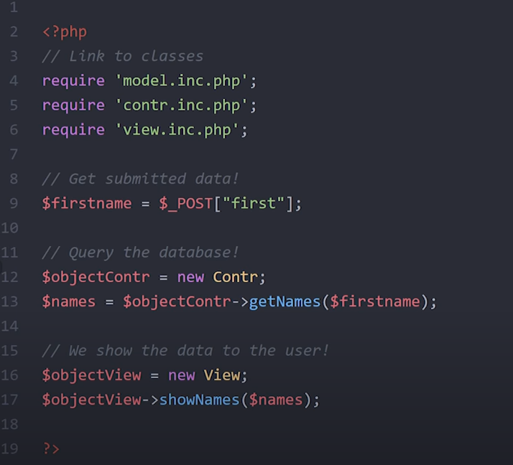
Procedural VS OOP (ctnd)

Slide 10
Design Patterns
DB
DB
MVC Model
Model
Model
Controller
View
Controller
View

Slide 11
Classes
A class is a blueprint that defines the structure and behavior of a specific type of object.
Classes contain properties (variables) and methods (functions)
Objects are instances of classes
The properties of an object store its data
The methods of an object operates on that data.

Slide 12
Defining Classes
Classes in PHP are defined using the “class” keyword followed by “class name”
The properties and methods of a class are defined inside the class definition, within curly braces ({})
Properties refers to variables inside class

Slide 13
Defining Classes (Cont…)
class Fruit {
// Properties
public $name;
public $color;
// Methods
function set_name($name) {
$this->name = $name;
}
function get_name() {
return $this->name;
}
}

Slide 14
Define Objects
Classes are nothing without objects!
We can create multiple objects from a class.
Each object has all the properties and methods defined in the class, but they will have different property values.
For example, $apple and $banana might be instances of the class Fruit above
Objects of a class is created using the “new” keyword.

Slide 15
Define Objects (Cont …..)
Class | Objects
class Fruit { // Properties public $name; public $color; // Methods function set_name($name) { $this->name = $name; } function set_color($color) { $this->color = $color; } function get_name() { return $this->name; } function get_color() { return $this->color; } } | $apple = new Fruit(); $banana = new Fruit(); $apple->set_name('Apple'); $banana->set_name('Banana'); $apple->set_color('Red'); //Print name echo $apple->get_name(); echo "<br>"; echo $banana->get_name(); //Print name echo "Name: " . $apple->get_name(); echo "<br>"; echo "Color: " . $apple->get_color();

Slide 16
Define Objects (Cont …..)
class User {
public $username;
public $email;
public function __construct($username, $email) {
$this->username = $username;
$this->email = $email;
}
public function getUsername() {
return $this->username;
}
public function getEmail() {
return $this->email;
}
}

Slide 17
Define Objects (Cont …..)
The $this keyword refers to the current object
It is only available inside methods.
The arrow operator (->) is used to access the properties and methods of an object
For example, from the class “User” defined above; we can define an object as follows;
$user = new User("John Doe", "john.doe@example.com");
To access the object above
echo $user->username; // Outputs: "John Doe"
echo $user->email; // Outputs: "john.doe@example.com"
echo $user->getUsername(); // Outputs: "John Doe"
echo $user->getEmail(); // Outputs: "john.doe@example.com"

Slide 18
Classes Vs Objects
Classes define a set of rules for objects they create.
You can create multiple objects from one class
Classes can be extended
Objects are created by instantiating a class.
Object instantiation determines what the object can do.

Slide 19
Visibility & Inheritance in PHP

Slide 20
Access Modifiers
There three (3) access modifiers in PHP
  Public: gives the least privacy
  Private: provide maximum privacy
  Protected: provide intermediate privacy
They are used in the definition of the member functions and data members
They controls where and how properties & methods of a base class can be inherited by the child classes.
They are used to restrict access of the base class from the child class to encapsulate the data.
This is popularly known as data hiding or Encapsulation.

Slide 21
Public
This level has no restrictions
It can be called in any scope.
A public property of an object can be both retrieved and modified from anywhere in a program
  in the class
  a subclass, or
  from outside of the class
It is a default behavior when visibility is not declared
Therefore, Technically a method declaration does not need to be proceeded by a visibility keyword to make it public.
This is because of backward-compatibility concerns with PHP4, which did not have visibility.
But for future compatibility reasons, for code explicit and its intent, you should always use a visibility keyword.

Slide 22

Public (cont…..)
<?php
// Define the base class
class Jewellery {
public $price = "We have a fixed price of 100000";
function printMessage() {
echo $this->price;
echo PHP_EOL;
}
}
// define the derived classes
class Necklace extends Jewellery {
function print(){
echo $this->price;
echo PHP_EOL;
}
}
// create the object of the derived class.
$obj= new Necklace;
// call the functions
echo $obj->price;
echo PHP_EOL;
$obj->printMessage();
$obj->print();
?>

Slide 23
Private (cont……)
This level is more restrictive.
A private property or method can’t be accessed by a subclass.
If you have a class with a protected property and a private property and then extend that class in the subclass, you can access the protected property, but not the private property.

Slide 24
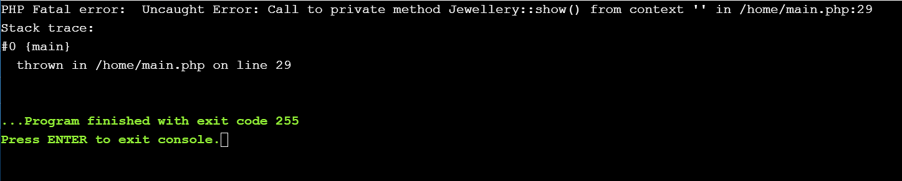
Private
//Filename: main.php
<?php
// Define the base class
class Jewellery {
private $price = "We have a fixed price of 100000";
private function show(){
echo "This is a private method of a base class";
}
}
// define the derived classes
class Necklace extends Jewellery {
function printPrice()
{
echo $this->price;
}
}
// create the object of the derived class
$obj= new Necklace;
// this line is trying to call a private method. This will throw error
$obj->show();
// this will also throw error
$obj->printPrice();
?>
You can only access private members indirectly using public member functions in the class.
If the private members are accessed by a public member in a class, then any child class accessing this public function can also access that private member.

Slide 25
Protected (cont….)
This is the second level of properties and methods privacy
Protected properties and methods can be accessed
  from inside the class they are declared, or
  in any class that extends them.
They can’t be accessed from outside the class or subclass.

Slide 26

Protected
<?php
// Define the base class
class Jewellery {
protected $price1 = 10000;
protected $price2 = 20000;
// Subtraction Function
function total()
{
echo $sum = $this->price1 + $this->price2;
echo PHP_EOL;
}
}
// define the derived classes
class Necklace extends Jewellery {
function printInvoice()
{
$tax = 100;
echo $sub = $this->price1 + $this->price2 + $tax;
echo PHP_EOL;
}
}
$obj= new Necklace;
$obj->total();
$obj->printInvoice();
?>

Slide 27
Inheritance
When a child class inherits from a base class,
  it has direct access to all the non-private members of the base class.
  And even the private members can be accessed indirectly.

Slide 28
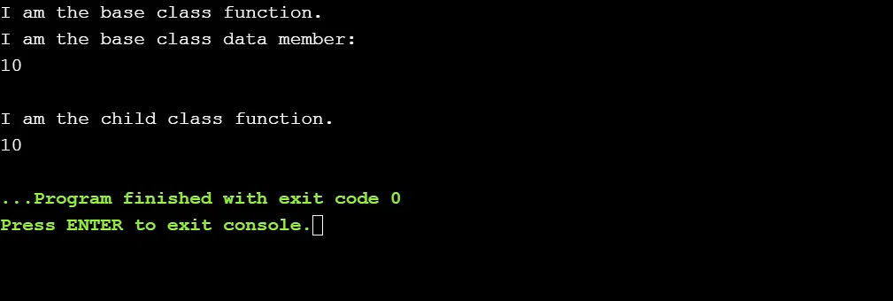
Inheritance
<?php
// Define the base class
class base_class {
// data member of the base class
public $data_mem = 10;
// member function of the base class
public function member_func() {
echo "I am the base class function.";
echo "I am the base class data member: ";
echo $this->data_mem;
}
}
// define the derived classes
class child_class extends base_class {
// member function of the child class
function child_func() {
echo "I am the child class function.";
echo $this->data_mem;
}
}
// create the object of the derived class
$obj= new child_class;
// call method of the base class
$obj->member_func();
// call method of the child class
$obj->child_func();
?>

Slide 29
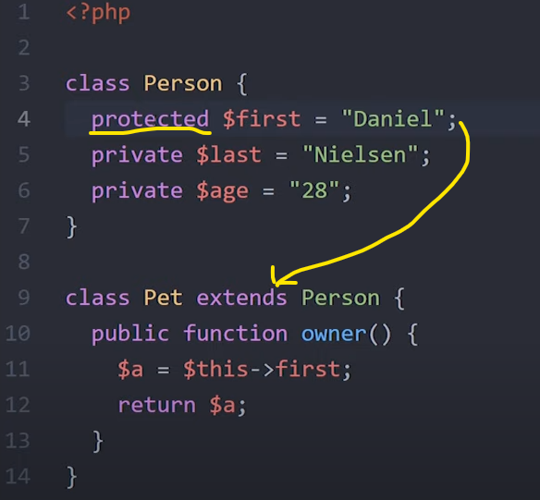
Visibility & Inheritance
Inheritance

Slide 30
Resources for Learning OOP
GitHub Repositories
GitHub is a go-to resource for information.
3 resources that will expand your knowledge of PHP.
  Learn Modern PHP – a curated resource for PHP tutorials
  Learning OOP in PHP – a collection of object-oriented programming concepts for PHP developers
  OOP-PHP – a general overview of PHP

Slide 31
References
OOP Official PHP Reference Guide by php.net
Object-oriented Programming Guide by Mozilla
Hacking with PHP by Paul Hudson
PHP: The Right Way by Josh Lockhard & Phil Sturgeon
Practical PHP Testing by Giorgio Sironi

