Slide 1
PYTHON PROGRAMMING
LECTURE 1
SALIM DIWANI

Slide 2
COURSEWORK
TWO TEST, EACH CARRIES 20 MARKS
TWO ASSIGNMENT EACH CARRIES 10 MARKS
FOUR QUIZES EACH CARRIES 5 MARKS
ATTENDANCE CARRIES 5 MARKS
PLEASE BE AWARE THAT CLASS ATTENDANCE AND PROMPTNESS ARE MANDATORY.

Slide 3
INTRODUCTION
Python is a high level, general purpose and very popular programming language like C, C++, Perl, and Java.
As you might infer from the name “high-level language,” there are also low level languages, sometimes referred to as “machine languages” or “assembly languages.”

Slide 4
INTRODUCTION
Loosely speaking, computers can only execute programs written in low-level languages. Thus, programs written in a high-level language have to be processed before they can run.
This extra processing takes some time, which is a small disadvantage of high-level languages.

Slide 5
INTRODUCTION
Advantages of High Level Languages
It is much easier to program in a high level language. Programs written in a high-level language take less time to write, they are shorter and easier to read, and they are more likely to be correct.

Slide 6
INTRODUCTION
Advantages of High Level Languages
High-level languages are portable, meaning that they can run on different kinds of computers with few or no modifications. Low-level programs can run on only one kind of computer and have to be rewritten to run on another.

Slide 7
INTRODUCTION
Due to these advantages, almost all programs are written in high-level languages. Low-level languages are used only for a few specialized applications.
Two kinds of programs process high-level languages into low-level languages: interpreters and compilers.

Slide 8
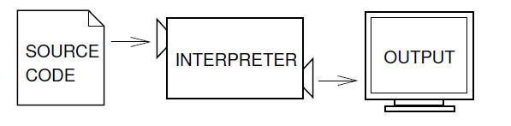
INTRODUCTION
Interpreter
An interpreter reads a high-level program and executes it, meaning that it does what the program says. It processes the program a little at a time, alternately reading lines and performing computations.

Slide 9
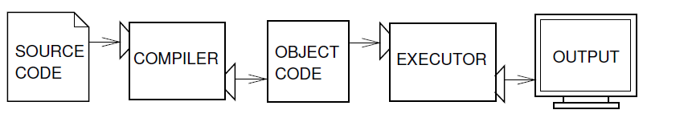
INTRODUCTION
Compiler
A compiler reads the program and translates it completely before the program starts running. In this case, the high-level program is called the source code, and the translated program is called the object code or the executable. Once a program is compiled, you can execute it repeatedly without further translation.

Slide 10
INTRODUCTION
Python is considered an interpreted language because Python programs are executed by an interpreter. There are two ways to use the interpreter: command-line mode and script mode. In command-line mode, you type Python programs and the interpreter prints the result:

Slide 11
INTRODUCTION
$ python
Python 2.4.1 (#1, Apr 29 2005, 00:28:56)
Type "help", "copyright", "credits" or "license" for more information.
>>> print 1 + 1
2

Slide 12
INTRODUCTION
The first line of this example is the command that starts the Python interpreter.
The next two lines are messages from the interpreter.
The third line starts with >>>, which is the prompt the interpreter uses to indicate that it is ready.
We typed print 1 + 1, and the interpreter replied 2.

Slide 13
INTRODUCTION
Alternatively, you can write a program in a file and use the interpreter to execute the contents of the file.
Such a file is called a script. For example, we used a text editor to create a file named diwani.py with the following contents:
print 1 + 1

Slide 14
INTRODUCTION
By convention, files that contain Python programs have names that end with .py.
To execute the program, we have to tell the interpreter the name of the script:
$ python diwani.py
2

Slide 15
INTRODUCTION
Python is being used in web development, machine learning applications, etc.
Python program are generally smaller than the other programming languages.

Slide 16
INTRODUCTION
Programmers have to type relatively less and the indentation requirement of the language, makes the readable at the time.
Very simple syntax and easy to learn
print (“Hello World”)

Slide 17
INTRODUCTION
General purpose language (Simple yet very powerful language)
  Console Application and Scripts
  Desktop Application
  Game Development
  Machine learning, Deep learning, AI, Big data etc.

Slide 18
INTRODUCTION
Multiparadigm Support
  Procedural style Programming like C.
  OOPs like Java (promote the use of classes and objects)
  Functional programming like list (support for features like map and filter)
  Scripting

Slide 19
INTRODUCTION
Portable or Platform Independent
  Programs are typically first compiled into an intermediate code, then the code is run by the interpreter.

Slide 20
INTRODUCTION
Dynamically Typed
In Python, being dynamically typed means that the type of a variable is interpreted at runtime, and it can change during the execution of a program. Unlike statically typed languages where the variable's type must be declared before it is used, Python allows you to create variables without explicitly stating their type.

Slide 21
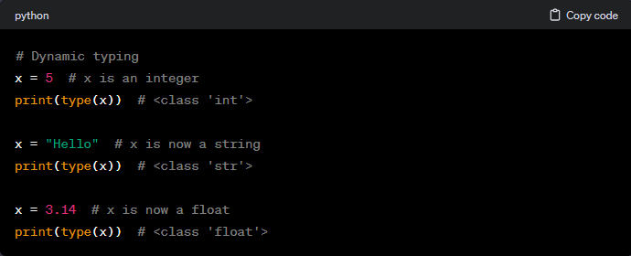
INTRODUCTION

Slide 22
INTRODUCTION
In this example, the variable x starts as an integer, then becomes a string, and later becomes a float. Python's dynamic typing provides flexibility but also requires careful consideration to avoid unexpected behavior. It's important for developers to be aware of the types of variables they are working with, especially in larger programs.

Slide 23
INTRODUCTION
Dynamically Typed
x = 10
y = “geeks”
x = “Python”
This feature is different from C++ & Java. They are statically typed.

Slide 24
INTRODUCTION
Automatic Garbage Collection
  It means when you dynamically allocate memory so you don’t have to worry to realizing this memory.

Slide 25
INTRODUCTION
  In Python, the built-in garbage collector takes care of identifying and reclaiming memory occupied by objects that are no longer referenced by the program. Developers do not need to explicitly free memory or manage the deallocation of objects as the garbage collector handles this automatically.

Slide 26
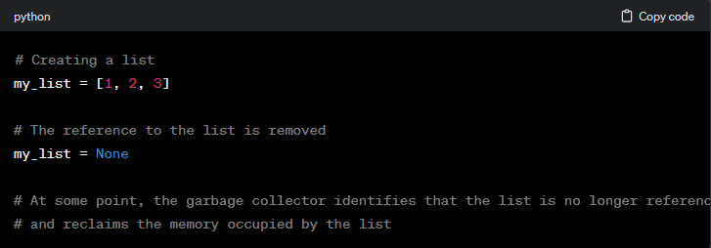
INTRODUCTION

Slide 27
INTRODUCTION
In this example, when my_list is set to None, the list is no longer referenced, and the garbage collector will eventually reclaim the memory used by that list.
Automatic Garbage Collection is a feature that contributes to the ease of development and robustness of programs, particularly in memory-managed languages like Python.

Slide 28
INTRODUCTION
Popular application built in Python
YouTube: YouTube has used Python for various purposes, including some of its backend services. Python's simplicity and readability make it suitable for certain tasks in YouTube's infrastructure.

Slide 29
INTRODUCTION
Popular application built in Python
Netflix: Python is used at Netflix for various purposes, including its Content Delivery API and certain recommendation algorithms. It's not the primary language for critical performance-related tasks but is utilized for scripting and tooling.

Slide 30
INTRODUCTION
Popular application built in Python
Quora: Quora's web application and parts of its backend are built using Python. Python's ease of use and the availability of frameworks like Django have been beneficial for developing the platform.

Slide 31
INTRODUCTION
Popular application built in Python
Instagram: Instagram, like many other web applications, relies on Django, a Python web framework, for its backend services. Python's rapid development capabilities have contributed to the efficiency of building and maintaining Instagram's features.

Slide 32
INTRODUCTION
Popular application built in Python
Dropbox: Python was one of the original languages used to build Dropbox. It's used for various purposes, including server-side logic and APIs. Over time, they've incorporated other languages for performance-critical components.

Slide 33
What is a program?
A program is a sequence of instructions that specifies how to perform a computation.
Sequence of Instructions: A program is essentially a set of step-by-step instructions that a computer can follow to perform a specific task or computation.

Slide 34
What is a program?
A program is a sequence of instructions that specifies how to perform a computation.
Computation: The nature of the computation can vary widely. It might involve mathematical calculations, logical operations, symbolic manipulations, data processing, and more. The type of computation depends on the problem the program is designed to solve.

Slide 35
What is a program?
Mathematical Computation: Many programs involve mathematical operations, such as solving equations or performing calculations. This is common in scientific and engineering applications.

Slide 36
What is a program?
Symbolic Computation: Programs can also manipulate symbols or text. For example, a text editor program performs symbolic computations when you search and replace text in a document.

Slide 37
What is a program?
Compilation: Compilation is a process where a high-level programming language is translated into machine code or an intermediate code that can be executed by a computer. This is a crucial step in the execution of many programs.

Slide 38
What is a program?
The details look different in different languages, but a few basic instructions appear in just about every language:
input: Get data from the keyboard, a file, or some other device.
output: Display data on the screen or send data to a file or other device.

Slide 39
What is a program?
math: Perform basic mathematical operations like addition and multiplication.
conditional execution: Check for certain conditions and execute the appropriate sequence of statements.
repetition: Perform some action repeatedly, usually with some variation.

Slide 40
What is a program?
Believe it or not, that’s pretty much all there is to it. Every program you’ve ever used, no matter how complicated, is made up of instructions that look more or less like these. Thus, we can describe programming as the process of breaking a large, complex task into smaller and smaller subtasks until the subtasks are simple enough to be performed with one of these basic instructions.

Slide 41
What is debugging?
Programming is a complex process, and because it is done by human beings, it often leads to errors. For whimsical reasons, programming errors are called bugs and the process of tracking them down and correcting them is called debugging.
"Programming is the art of telling a computer what to do, and the computer doing it exactly." - Donald Knuth

Slide 42
What is debugging?
Complex Process: Programming involves writing a set of instructions for a computer to execute. These instructions need to be precise and correct to achieve the desired outcome. The complexity arises from managing data, logic, and various other elements in a program.

Slide 43
What is debugging?
Human Involvement: Since programming is a human activity, errors are inevitable. These errors are commonly referred to as "bugs." Bugs can manifest as syntax errors, logical errors, or runtime errors, and they can occur for various reasons, including typos, incorrect logic, or unexpected data.

Slide 44
What is debugging?
Debugging: Debugging is the process of identifying, isolating, and fixing bugs in a program.
Programmers use various tools and techniques to debug, including print statements, debugging tools, and systematic code analysis. Debugging is a crucial skill for any programmer.

Slide 45
What is debugging?
Whimsical Term - Bugs: The term "bug" has a historic origin. Legend has it that the term was coined by Rear Admiral Grace Hopper in the 1940s when she found an actual moth causing a malfunction in the Harvard Mark II computer. She taped the moth into the logbook, noting it as the "first actual case of bug being found.“
https://www.youtube.com/watch?v=oE2uls6iIEU
https://www.youtube.com/watch?v=BttvTL_O31g

Slide 46
What is debugging?
Three kinds of errors can occur in a program: syntax errors, runtime errors, and semantic errors. It is useful to distinguish between them in order to track them down more quickly.

Slide 47
Syntax errors
In Python, a syntax error occurs when the interpreter encounters code that violates the language's rules regarding the structure of statements and expressions. These errors prevent the interpreter from parsing the code correctly, and as a result, the program cannot be executed until the syntax errors are fixed.

Slide 48
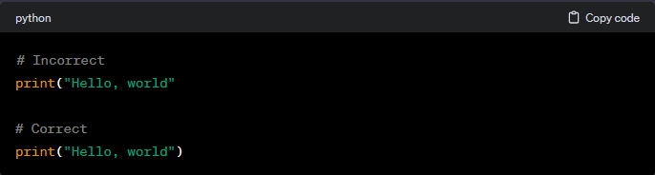
Syntax errors
Here are common scenarios that lead to syntax errors in Python:
Missing Parenthesis, Brackets, or Braces:

Slide 49
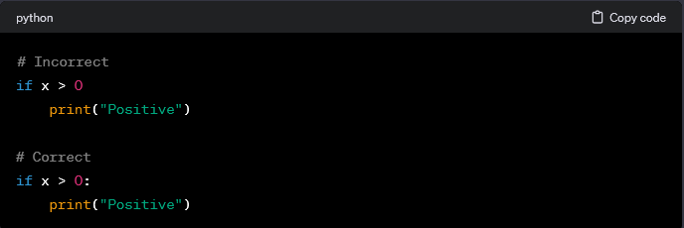
Syntax errors
Here are common scenarios that lead to syntax errors in Python:
Missing Colons:

Slide 50
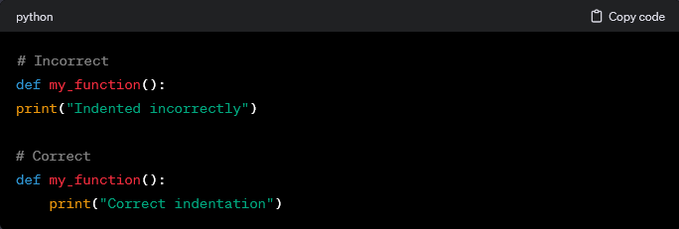
Syntax errors
Here are common scenarios that lead to syntax errors in Python:
Incorrect Indentations:

Slide 51
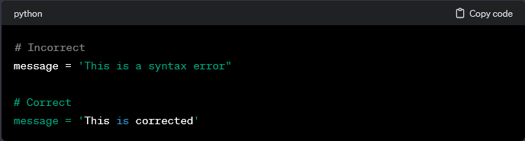
Syntax errors
Here are common scenarios that lead to syntax errors in Python:
Mismatched quotes:

Slide 52
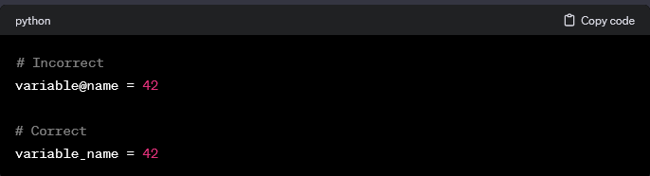
Syntax errors
Here are common scenarios that lead to syntax errors in Python:
Invalid Characters:

Slide 53
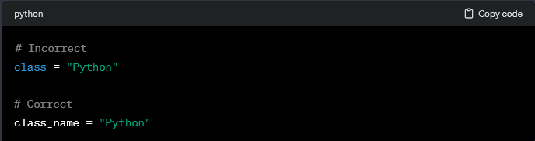
Syntax errors
Here are common scenarios that lead to syntax errors in Python:
Using Keywords Incorrectly:

Slide 54
Runtime errors
Runtime errors, also known as exceptions, occur when a Python program is syntactically correct but encounters an issue during execution. These errors are not detected by the interpreter until the program is actually running. Unlike syntax errors, which prevent the program from running at all, runtime errors can occur after the program has started executing.
Here are some common types of runtime errors in Python:

Slide 55

Runtime errors
ZeroDivisionError:
This error occurs when you try to divide a number by zero.

Slide 56

Runtime errors
TypeError:
This error occurs when you perform an operation on data types that are not compatible.

Slide 57

Runtime errors
IndexError:
This error occurs when you try to access an element at an index that is outside the range of the list.

Slide 58

Runtime errors
NameError:
This error occurs when you try to use a variable or a function that has not been defined.

Slide 59

Runtime errors
ValueError:
This error occurs when you try to perform an operation on a value that is of the correct type but has an invalid value.

Slide 60

Runtime errors
FileNotFoundError:
This error occurs when you try to open a file that does not exist.

Slide 61
Runtime errors
When a runtime error occurs, Python stops the execution of the program and prints an error message to the console. The error message includes information about the type of error, the location in the code where the error occurred, and sometimes additional details about the cause of the error.
Developers can use tools like try-except blocks to handle runtime errors gracefully, allowing the program to continue running or providing meaningful error messages to users.

Slide 62
Semantic errors
The third type of error is the semantic error. If there is a semantic error in your program, it will run successfully, in the sense that the computer will not generate any error messages, but it will not do the right thing. It will do something else. Specifically, it will do what you told it to do. The problem is that the program you wrote is not the program you wanted to write.

Slide 63
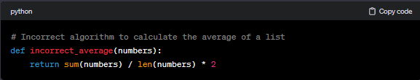
Semantic errors
Incorrect Algorithm: If the algorithm used to solve a problem is flawed, the program will produce incorrect results. For instance, using an incorrect mathematical formula or an inappropriate algorithm for a specific task can lead to semantic errors.

Slide 64
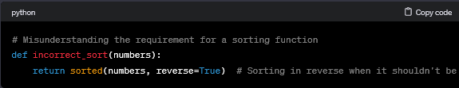
Semantic errors
Misunderstanding Requirements: If the developer misunderstands the requirements of a program, it can result in semantic errors. This might involve misinterpreting the expected behavior or functionality.

Slide 65
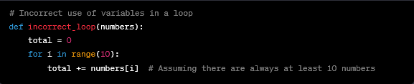
Semantic errors
Variable Misuse: Incorrectly using variables, such as using the wrong variable or misunderstanding its scope, can lead to semantic errors.

Slide 66
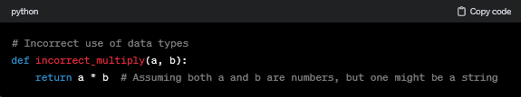
Semantic errors
Improper Data Types: Using data types incorrectly can result in semantic errors. This might involve performing operations on incompatible data types.

Slide 67
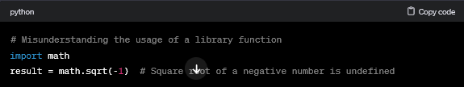
Semantic errors
Misunderstanding API Usage: If the program relies on external libraries or APIs, misunderstanding how to use them can introduce semantic errors.

Slide 68
Semantic errors
Detecting semantic errors often requires a thorough understanding of the problem domain and careful code review. Automated testing and thorough debugging practices can help identify and correct semantic errors during the development process.

Slide 69
Experimental debugging
Experimental debugging, also known as "printf debugging" or "print debugging," is a method of debugging code by inserting print statements or logging messages at various points in the code to observe its behavior and understand what's happening during execution.
This approach is often used when traditional debugging tools or techniques are not sufficient or convenient for the situation.

Slide 70
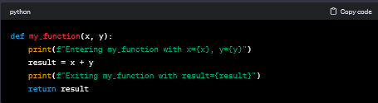
Experimental debugging
Inserting Print Statements: Developers strategically insert print statements or logging commands in the code at points where they suspect issues or want to track the flow of execution. These print statements output information such as variable values, the program state, or specific messages.

Slide 71


Experimental debugging
Observing Output: The program is then executed, and the developer observes the output produced by the inserted print statements. This output helps in understanding the sequence of events, the values of variables at different points, and any unexpected behaviors.

Slide 72
Experimental debugging
Iterative Process: Developers may iteratively add, modify, or remove print statements based on their observations. By strategically placing print statements, they can narrow down the location of issues, identify unexpected behaviors, and gain insights into the program's flow.

Slide 73
Experimental debugging
Understanding and Fixing Issues: The information gathered from print statements helps in understanding the root causes of issues or unexpected behaviors. Once identified, developers can make the necessary corrections to the code.

Slide 74
Experimental debugging
Advantages:
Simplicity: Experimental debugging is straightforward and doesn't require sophisticated debugging tools.
Flexibility: It can be applied in various environments and programming languages.

Slide 75
Experimental debugging
Drawbacks:
Limited Precision: The granularity of information provided by print statements might be insufficient for complex issues.
Code Pollution: Adding and removing print statements can clutter the code if not managed well.

Slide 76
Formal and natural languages
Formal Languages:
Purpose: Formal languages are designed for specific, well-defined applications, often in the realm of mathematics, logic, computer science, and programming.
Syntax: Formal languages have precise and unambiguous syntax rules. The rules define how symbols, characters, or elements can be combined to form valid expressions or statements.

Slide 77
Formal and natural languages
Formal Languages:
Use of Symbols: Formal languages often use symbols, notations, or alphabets with a clear and limited set of meanings. These symbols convey precise information.
Rigorous Structure: Expressions in formal languages follow a rigorous structure and are subject to rules that dictate their correctness.

Slide 78
Formal and natural languages
Formal Languages:
Example: Programming languages (e.g., Python, Java), formal logic languages (e.g., propositional logic, predicate logic), regular expressions, and mathematical notations are examples of formal languages.

Slide 79
Formal and natural languages
Natural Languages:
Purpose: Natural languages are languages that have evolved organically within human societies for communication. They include languages like English, Spanish, Mandarin, etc.
Syntax: Natural languages have complex and often ambiguous syntax. Grammar rules exist, but they can have exceptions and variations.

Slide 80
Formal and natural languages
Natural Languages:
Rich Vocabulary: Natural languages have vast vocabularies with words that can have multiple meanings (bank" (financial institution, the land alongside a river)), "bat" (flying mammal, an object used in baseball) and context is crucial for understanding.
Expressiveness: Natural languages are highly expressive and can convey a wide range of meanings, including abstract concepts, emotions, and cultural nuances.

Slide 81
Formal and natural languages
Natural Languages:
Evolution and Variability: Natural languages evolve over time, and different regions or communities may have variations in vocabulary, pronunciation, and idioms.

Slide 82
Formal and natural languages
Key Differences:
Formal languages are designed for specific applications with precise rules, while natural languages have evolved for general communication.
The syntax of formal languages is strict and unambiguous, while natural languages may have more flexible and context-dependent syntax.

Slide 83
Formal and natural languages
Key Differences:
Formal languages often use symbols and notations, while natural languages rely on a rich vocabulary of spoken or written words.
Natural languages are used by humans for everyday communication, while formal languages are used in specific fields for computation, logic, and programming.

Slide 84
Formal and natural languages
And most importantly:
Programming languages are formal languages that have been designed to express computations.
Formal languages tend to have strict rules about syntax. For example, 3 + 3 = 6 is a syntactically correct mathematical statement, but 3=+6$ is not. H2_{O} is a syntactically correct chemical name, but ₂Zz is not.

Slide 85
Formal and natural languages
Syntax rules come in two flavors, pertaining to tokens and structure. Tokens are the basic elements of the language, such as words, numbers, and chemical elements. One of the problems with 3=+6$ is that $ is not a legal token in mathematics (at least as far as we know). Similarly, ₂Zz is not legal because there is no element with the abbreviation Zz.

Slide 86
Formal and natural languages
The second type of syntax error pertains to the structure of a statement—that is, the way the tokens are arranged. The statement 3=+6$ is structurally illegal because you can’t place a plus sign immediately after an equal sign. Similarly, molecular formulas have to have subscripts after the element name, not before.

Slide 87
Assignment
Install Python Anaconda current version
Start working with command line
Get familiar with different command
I will share the command line crash course for practicing on Lab

