Slide 1
PYTHON PROGRAMMING
LECTURE 2
SALIM DIWANI

Slide 2
Values and types
In Python, a value is a fundamental piece of data that a program works with. Values can belong to different types, and the type of a value determines what operations can be performed on it. Here are some examples of values and their types in Python:

Slide 3
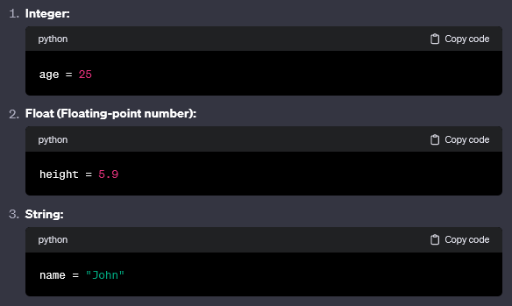
Values and types

Slide 4
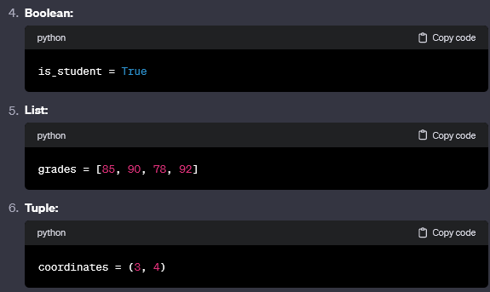
Values and types

Slide 5
Values and types
If you are not sure what type a value has, the interpreter can tell you.
>>> type(’Hello, World!’)
<type ’str’>
>>> type(17)
<type ’int’>

Slide 6
Values and types
Not surprisingly, strings belong to the type str and integers belong to the type int.
Less obviously, numbers with a decimal point belong to a type called float, because these numbers are represented in a format called floating-point.
>>> type(3.2)
<type ’float’>

Slide 7
Values and types
What about values like ’17’ and ’3.2’? They look like numbers, but they are in quotation marks like strings.
>>> type(’17’)
<type ’str’>
>>> type(’3.2’)
<type ’str’>
They’re strings.

Slide 8
Values and types
When you type a large integer, you might be tempted to use commas between groups of three digits, as in 1,000,000. This is not a legal integer in Python, but it is a legal expression:
>>> print 1,000,000
1 0 0

Slide 9
Values and types
Well, that’s not what we expected at all! Python interprets 1,000,000 as a comma-separated list of three integers, which it prints consecutively.
This is the first example we have seen of a semantic error: the code runs without producing an error message, but it doesn’t do the “right” thing.

Slide 10
Variables
Variable is a name that is used to refer to memory location. Python variable is also known as identifier and used to hold value.
In python, we don’t need to specify the type of variable because python is infer language and smart enough to get variable type.

Slide 11
Variables
In Python, a variable is declared and assigned a value using the assignment operator =. The variable is on the left-hand side of the operator, and the value being assigned — which can be an expression such as 2 + 2 and can even include other variables — is on the right-hand side:

Slide 12
Variables
x = 1 # assign variable x the value 1
y = x + 5 # assign variable y the value of x plus 5
z = y # assign variable z the value of y

Slide 13
Variables
Example:-
price = 100
tax = 18
total-price = price + tax
print (total-price)
output = 118

Slide 14
Variables
>>> message = "What’s up, Doc?"
>>> n = 17
>>> pi = 3.14159
The first assigns the string "What’s up, Doc?" to a new variable named message.
The second gives the integer 17 to n,
The third gives the floating-point number 3.14159 to pi.

Slide 15
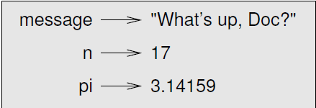
Variables
A common way to represent variables on paper is to write the name with an arrow pointing to the variable’s value.
This kind of figure is called a state diagram

Slide 16
How Variables Works
x
x = 10
y = geeks
z = 20
If we say, w = z
then
10
geeks
y
z
20
z
20
w

Slide 17
How Variables Works
w
but if, w = 30
Print (x) 10
Print (y) geeks
Print (z) 20
Print (w) 30
10

Slide 18
Variables
Note: using a variable without assigning it cause error
Example:-
print (x)
output: Name Error: name ‘x’ is not assigned

Slide 19
Variables
Variables are fundamental to programming for two reasons:
Variables keep values accessible:
For example, you can assign the result of some time-consuming operation to a variable so that your program does not have to perform the operation each time you need to use the result.

Slide 20
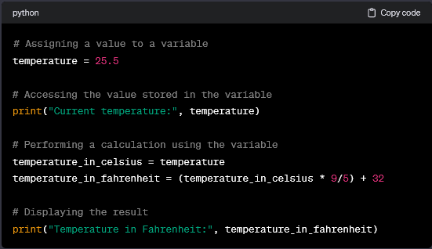
Variables

Slide 21
Variables
2. Variables give values context:
The number 28 could mean lots of different things, such as the number of students in a class, the number of times a user has accessed a website, and so on. Giving the value 28 a name like num_students makes the meaning of the value clear.

Slide 22
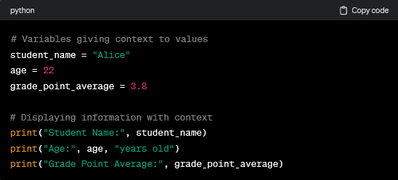
Variables

Slide 23
Rules for Valid Variables Names
Variable names can be as long or as short as you like, but there are a few rules that you must follow. Variable names may contain uppercase and lowercase letters (A–Z, a–z), digits (0–9), and underscores (_), but they cannot begin with a digit.

Slide 24
Rules for Valid Variables Names
For example, each of the following is a valid Python variable name:
  string1
  _a1p4a
  list_of_names

Slide 25
Rules for Valid Variables Names
The following aren’t valid variable names because
they start with a digit:
  9lives
  99_balloons
  2beOrNot2Be

Slide 26
Rules for Valid Variables Names
In addition to English letters and digits, Python
variable names may contain many different valid
Unicode characters. Unicode is a standard for
digitally representing characters used in most of
the world’s writing systems. That means variable
names can contain letters from non-English
alphabets, such as decorated letters like é and ü,
and even Chinese, Japanese, and Arabic symbols.

Slide 27
Rules for Valid Variables Names
However, not every system can display decorated
characters, so it’s a good idea to avoid them if
you’re going to share your code with people in
different regions.

Slide 28
Descriptive Names
Descriptive variable names are essential, especially for complex programs. Writing descriptive names often requires using multiple words. Don’t be afraid to use long variable names. In the following example, the value 3600 is assigned to the variable s:
s = 3600
The name s is totally ambiguous. Using a full word makes it a lot easier to understand what the code means:
seconds = 3600

Slide 29
Python Variable Naming Conventions
In many programming languages, it’s common to write variable names in mixedCase.
Example, numStudents and listOfNames
In Python, however, it’s more common to write variable names in lower_case_with_underscores.
Example, num_students and list_of_names

Slide 30
Python Variable Naming Conventions
There’s no rule mandating that you write your
variable names in lower_case_with_underscores. The practice is codified, though, in a document called PEP 8, which is widely regarded as the official style guide for writing Python.

Slide 31
Variable names and keywords
Programmers generally choose names for their variables that are meaningful—they document what the variable is used for.
Variable names can be arbitrarily long. They can contain both letters and numbers, but they have to begin with a letter. Although it is legal to use uppercase letters, by convention we don’t. If you do, remember that case matters. Bruce and bruce are different variables.

Slide 32
Variable names and keywords
The underscore character ( _ ) can appear in a name. It is often used in names with multiple words, such as my name or price of tea in china.
If you give a variable an illegal name, you get a syntax error:

Slide 33
Variable names and keywords
>>> 76trombones = ’big parade’
SyntaxError: invalid syntax
>>> more$ = 1000000
SyntaxError: invalid syntax
>>> class = ’Computer Science 101’
SyntaxError: invalid syntax

Slide 34
Variable names and keywords
76trombones is illegal because it does not begin with a letter.
more$ is illegal because it contains an illegal character, the dollar sign.
But what’s wrong with class? It turns out that class is one of the Python keywords. Keywords define the language’s rules and structure, and they cannot be used as variable names.

Slide 35
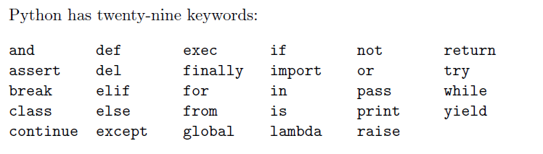
Variable names and keywords

Slide 36
Statements
A statement is an instruction that the Python interpreter can execute. We have seen two kinds of statements: print and assignment.
When you type a statement on the command line, Python executes it and displays the result, if there is one. The result of a print statement is a value. Assignment statements don’t produce a result.
A script usually contains a sequence of statements. If there is more than one statement, the results appear one at a time as the statements execute.

Slide 37
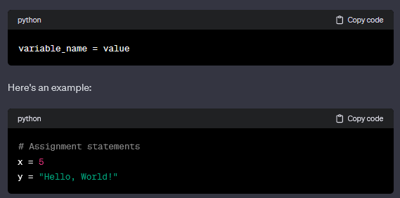
Statements
Assignment Statement:
The assignment statement is used to assign a value to a variable. The basic syntax is as follows:

Slide 38
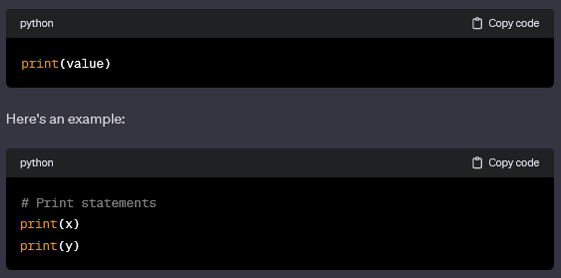
Statements
Print Statement:
The print statement is used to display information on the console. The basic syntax is as follows:

Slide 39
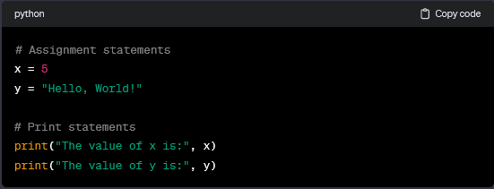
Statements
You can also print multiple values in a single statement:

Slide 40
Evaluating expressions
An expression is a combination of values, variables, and operators. If you type an expression on the command line, the interpreter evaluates it and displays the result:
>>> 1 + 1
2

Slide 41
Evaluating expressions
Although expressions contain values, variables, and operators, not every expression contains all of these elements. A value all by itself is considered an expression, and so is a variable.
>>> 17
17
>>> x
2

Slide 42
Operators and operands
An operator is a symbol of the programming language, which is able to operate on the values. For example, just as in arithmetic, the + (plus) sign is the operator which is able to add two numbers, giving the result of the addition.

Slide 43
Arithmetic operators: exponentiation
A ** (double asterisk) sign is an exponentiation (power) operator. Its left argument is the base, its right, the exponent.
Classical mathematics prefers notation with superscripts, just like this: 2³. Pure text editors don't accept that, so Python uses ** instead, e.g., 2 ** 3.

Slide 44
Example:
print(2 ** 3)
print(2 ** 3.)
print(2. ** 3)
print(2. ** 3.)
Remember:
It's possible to formulate the following rules based on this result:
  when both ** arguments are integers, the result is an integer, too;
  when at least one ** argument is a float, the result is a float, too.

Slide 45
Arithmetic operators: multiplication
An * (asterisk) sign is multiplication operator. Run the code below and check if integer vs. float rule is still working.
print(2 * 3)
print(2 * 3.)
print(2. * 3)
print(2. * 3.)

Slide 46
Arithmetic operators: division
A / (slash) sign is a divisional operator. The value in front of the slash is a dividend, the value behind the slash, a divisor.
Run the code below and analyze the results.
print(6 / 3)
print(6 / 3.)
print(6. / 3)
print(6. / 3.)

Slide 47
Arithmetic operators: integer division
A // (double slash) sign is an integer divisional
operator. It differs from the standard / operator in two details:
  its result lacks the fractional part - it's absent (for integers), or is always equal to zero (for floats); this means that the results are always rounded;
  it conforms to the integer vs. float rule.

Slide 48
Arithmetic operators: integer division
print(6 // 3)
print(6 // 3.)
print(6. // 3)
print(6. // 3.)
In the above example, Integer by integer division
gives an integer result. All other cases produce floats.
Integer division can also be called floor division. You
will definitely come across this term in the future.

Slide 49
Arithmetic operators: remainder (modulo)
The next operator is quite a peculiar one, because it has no equivalent among traditional arithmetic operators.
Its graphical representation in Python is the %
(percent) sign, which may look a bit confusing.
The result of the operator is a remainder left after the integer division.

Slide 50
Arithmetic operators: how not to divide
As you probably know, division by zero doesn't work.
Do not try to:
  perform a division by zero;
  perform an integer division by zero;
  find a remainder of a division by zero.

Slide 51
The subtraction operator, unary and binary operators
The subtraction operator is obviously the - (minus) sign, although you should note that this operator also has another meaning - it can change the sign of a number.
In subtracting applications, the minus operator
expects two arguments: the left (a minuend in
arithmetical terms) and right (a subtrahend).

Slide 52
The subtraction operator, unary and binary operators
For this reason, the subtraction operator is
considered to be one of the binary operators, just like the addition, multiplication and division operators.
But the minus operator may be used in a different (unary) way - take a look at the last line of the snippet below:
print(-4 - 4)
print(4. - 8)
print(-1. -1)

Slide 53
Operators and their priorities
Python precisely defines the priorities of all operators, and assumes that operators of a larger (higher) priority perform their operations before the operators of a lower priority. So, if you know that * has a higher priority than +, the computation of the final result should be obvious.
2 + 3 * 5

Slide 54
Operators and their priorities
Parentheses:
(): Parentheses are used to override the default precedence of operators and force a specific order of evaluation.
Exponentiation:
**: Exponentiation has the highest precedence.
Unary Plus and Minus:
+x, -x: Unary plus and minus.

Slide 55
Operators and their priorities
Multiplication, Division, and Floor Division:
*: Multiplication
/: Division
//: Floor division (quotient)
Modulus:
%: Modulus (remainder)
Addition and Subtraction:
+: Addition
-: Subtraction

Slide 56
Operators and their priorities
Bitwise Shifts:
<<, >>: Bitwise shifts
Bitwise AND, XOR, and OR:
&: Bitwise AND
^: Bitwise XOR (exclusive OR)
|: Bitwise OR (inclusive OR)

Slide 57
Operators and their priorities
Comparison Operators:
<, <=, >, >=: Less than, Less than or equal, Greater than, Greater than or equal
==, !=: Equal, Not equal
Logical NOT, AND, OR:
not: Logical NOT
and: Logical AND
or: Logical OR

Slide 58
Operators and their priorities
Conditional Expression (Ternary Operator):
x if condition else y: The ternary operator provides a concise way to write conditional expressions.
Assignment Operators:
=, +=, -=, *=, /=, //=, %=, **=: Assignment operators are used to assign values to variables.

Slide 59
Operators and their priorities
An example of an expression with multiple parentheses is here:
print((5 * ((25 % 13) + 100) / (2 * 13)) // 2)

Slide 60
Operations on strings
In Python, strings are sequences of characters, and you can perform various operations on strings. Here are some common string operations:

Slide 61
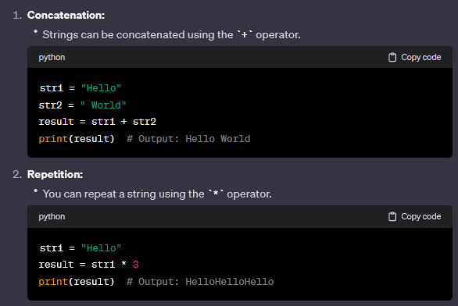
Operations on strings

Slide 62
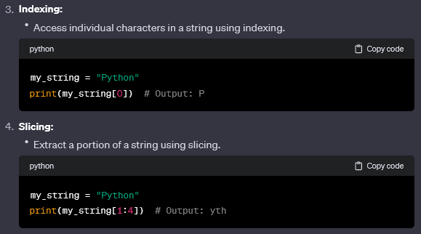
Operations on strings

Slide 63
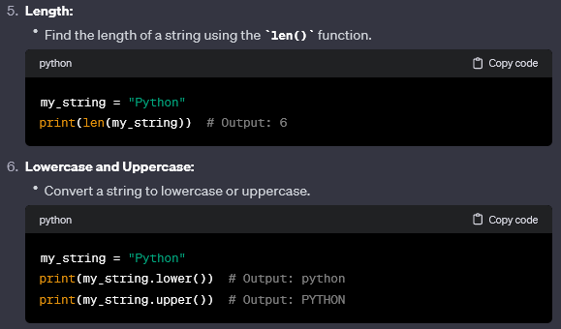
Operations on strings

Slide 64
Composition
So far, we have looked at the elements of a program—variables, expressions, and statements—in isolation, without talking about how to combine them. One of the most useful features of programming languages is their ability to take small building blocks and compose them.

Slide 65
Composition
For example, we know how to add numbers and we know how to print; it turns out we can do both at the same time:
>>> print 17 + 3
20
In reality, the addition has to happen before the printing, so the actions aren’t actually happening at the same time. The point is that any expression involving numbers, strings, and variables can be used inside a print statement.

Slide 66
Comments
As programs get bigger and more complicated, they get more difficult to read. Formal languages are dense, and it is often difficult to look at a piece of code and figure out what it is doing, or why.
For this reason, it is a good idea to add notes to your programs to explain in natural language what the program is doing. These notes are called comments, and they are marked with the # symbol:

Slide 67
Comments
# compute the percentage of the hour that has elapsed percentage = (minute * 100) / 60 In this case, the comment appears on a line by itself. You can also put comments at the end of a line: percentage = (minute * 100) / 60 # caution: integer division

Slide 68
Comments
Everything from the # to the end of the line is ignored—it has no effect on the program. The message is intended for the programmer or for future programmers who might use this code. In this case, it reminds the reader about the eversurprising behavior of integer division.

Slide 69
Comments
This sort of comment is less necessary if you use the integer division operation, //. It has the same effect as the division operator1, but it signals that the effect is deliberate. percentage = (minute * 100) // 60 The integer division operator is like a comment that says, “I know this is integer division, and I like it that way!”

Slide 70
Quiz
print((-2 / 4), (2 / 4), (2 // 4), (-2 // 4))
print((2 ** 4), (2 * 4.), (2 * 4))
print((2 % -4), (2 % 4), (2 ** 3 ** 2))
print((5 * ((25 % 13) + 100) / (2 * 13)) // 2)
print (3 + 2 + 1 - 5 + 4 % 2 - 1.0 / 4 + 6)

