Slide 1
Hardware OpenFlow Switches
High-performance Switches and Scalability in Modern Networks

Slide 2
GROUP NUMBER: FOUR
GROUP MEMBERS
NO | NAME | REG NO
1 | NYAMIZI SHIJA | T22-03-02725
2 | PUDENCIANA KIYEGA | T22-03-11584
3 | IBRAHIMU BONIFACE | T22-03-05565
4 | AMANI MLIMANDOLA | T22-03-05155

Slide 3
SCOPE
Introduction
The role of OpenFlow in hardware-based switching
Key hardware OpenFlow switch manufacturers
ASIC-based Switches vs Software Switches
Use Case of Hardware OpenFlow switches
Challenges in OpenFlow Hardware Adoption
Overcoming the Challenges
Conclusion
References

Slide 4
Introduction
The rapid evolution of network infrastructure has led to increased demands for efficient, scalable, and high-performance networking solutions.
Software-Defined Networking (SDN) has emerged as a transformative approach, allowing centralized control of network resources and enabling dynamic configuration to meet these demands.
Central to SDN is the OpenFlow protocol, which facilitates direct communication between the control plane and the data plane of network devices.

Slide 5
Introduction cont…
Hardware OpenFlow switches represent a significant advancement in this domain, integrating OpenFlow capabilities into specialized network hardware to achieve unparalleled forwarding performance and scalability.
Unlike software-based solutions, hardware OpenFlow switches leverage dedicated Application-Specific Integrated Circuits (ASICs) or Network Processing Units (NPUs), offering low latency, high throughput, and improved energy efficiency.
Prominent manufacturers such as Arista, Pica8, NoviFlow, HP, Dell, and Barefoot Networks (Intel Tofino) have developed a range of hardware OpenFlow switches that cater to diverse networking environments, including carrier networks, enterprise data centers, and Software-Defined Wide Area Networks (SD-WAN).

Slide 6
The role of OpenFlow in hardware-based switching
In hardware-based switching, OpenFlow acts as a standardized protocol that allows a central controller to directly program the forwarding behavior of network switches, essentially giving the controller granular control over how packets are routed through the network by manipulating the switch's flow tables, which are implemented in hardware, enabling dynamic and flexible network management within a Software-Defined Networking (SDN) architecture

Slide 7
The role of OpenFlow in hardware-based switching
OpenFlow in hardware-based switching enables centralized control by decoupling the control plane from the data plane, allowing dynamic flow management and policy enforcement.
This improves network flexibility, scalability, and performance by leveraging high-speed ASICs for efficient packet forwarding

Slide 8
Key hardware OpenFlow switch manufacturers
Key hardware OpenFlow switch manufacturers including Arista, Pica8, NoviFlow, HP, Dell, and Barefoot (Intel Tofino).
Arista Networks:
  Arista emphasizes software-driven networking with their EOS (Extensible Operating System) and CloudVision platform.
  Architecture: Their switches are designed for high performance and scalability, often used in data centers and cloud environments. They support OpenFlow and other SDN protocols, integrating with various controllers.
  Key Features:
    EOS: Programmable and modular network operating system.
    CloudVision: Network management and automation platform.High-performance switches with support for various protocols.

Slide 9
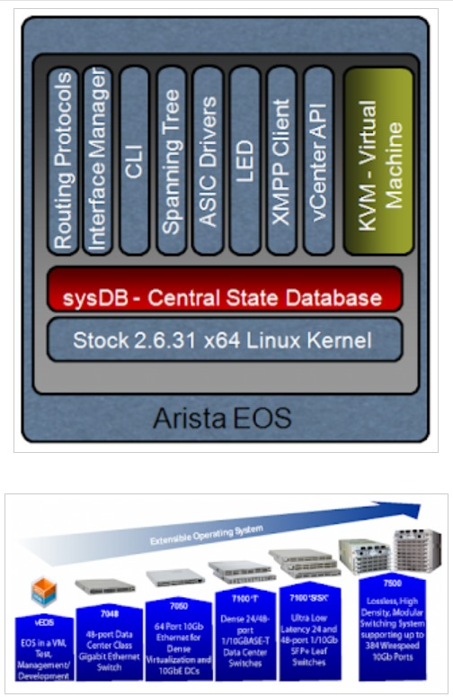
Key hardware OpenFlow switch manufacturers
Arista Architecture

Slide 10
Key hardware OpenFlow switch manufacturers
Pica8:
  Pica8 champions open networking with their PicOS network operating system and white-box hardware.
  Architecture: They promote disaggregation, allowing customers to choose their preferred hardware and software components. Their switches support OpenFlow and other SDN functionalities.
  Key Features: PicOS: Network operating system designed for open hardware. Support for various SDN controllers and applications. Focus on flexibility and cost-effectiveness.

Slide 11
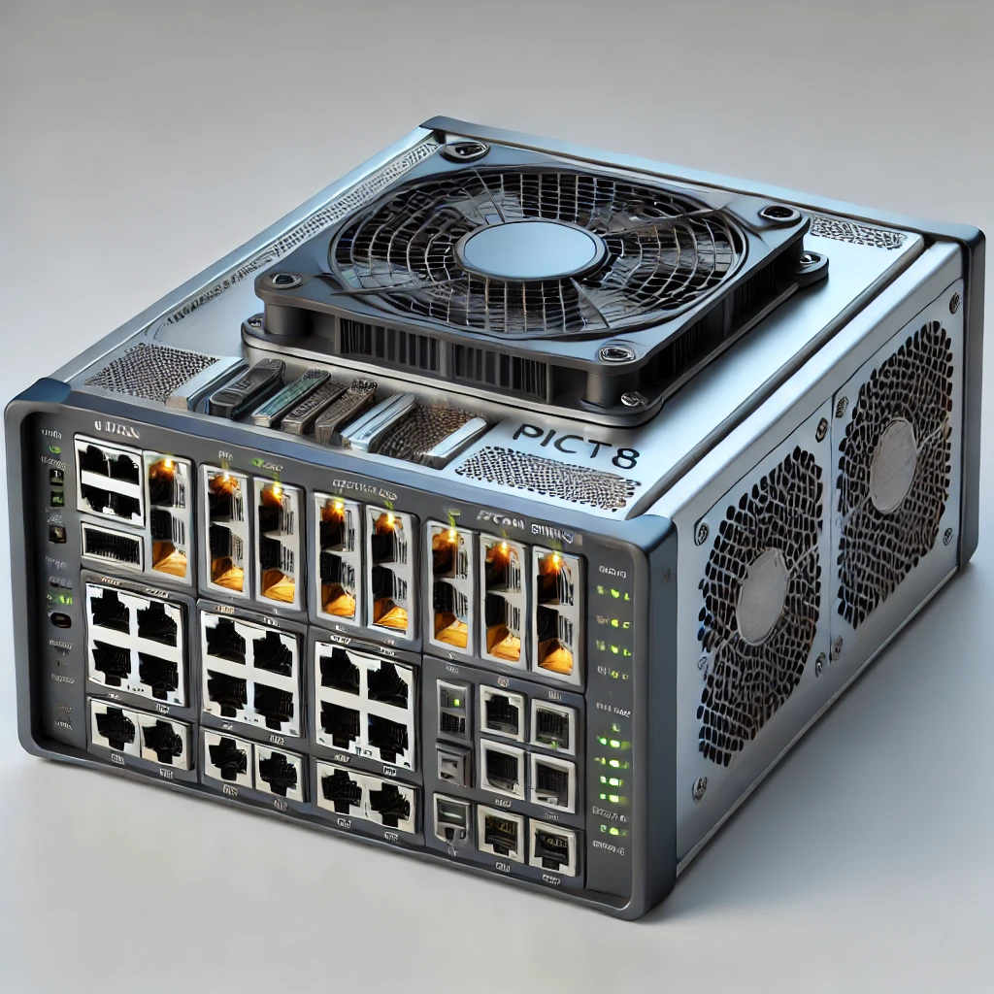
Key hardware OpenFlow switch manufacturers
PIC8 Switch

Slide 12
Key hardware OpenFlow switch manufacturers
HP (Hewlett Packard Enterprise):
  Focus: HPE offers a broad range of networking solutions, including switches with OpenFlow support.
  Architecture: Their switches are designed for enterprise and data center environments, integrating with their own network management tools and supporting various SDN controllers.
  Key Features: OpenFlow support across their product line. Integration with HPE Aruba networking solutions. Focus on reliability and scalability.

Slide 13
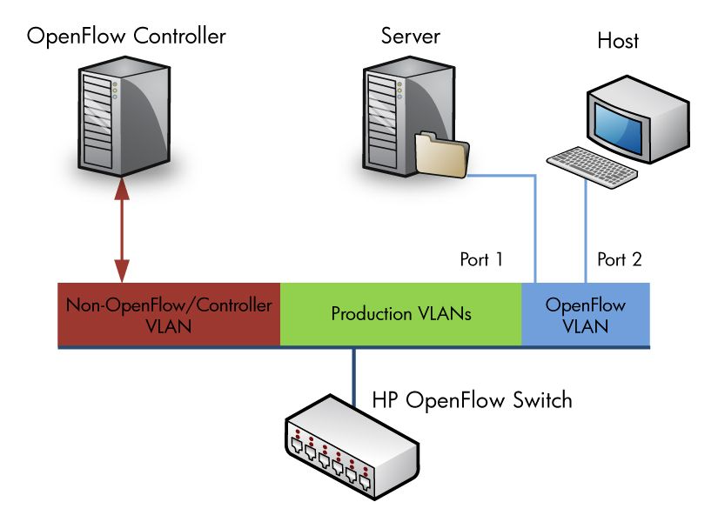
Key hardware OpenFlow switch manufacturers
HP Switches Architecture

Slide 14
Key hardware OpenFlow switch manufacturers
Dell Technologies:
  Focus: Dell provides networking solutions for various needs, including OpenFlow-enabled switches for enterprises and data centers.
  Architecture: Their switches are designed to integrate with their server and storage solutions, offering a comprehensive infrastructure offering. They support OpenFlow and other SDN protocols.
  Key Features: OpenFlow support on select switch models. Integration with Dell EMC infrastructure. Options for different network sizes and requirements.

Slide 15
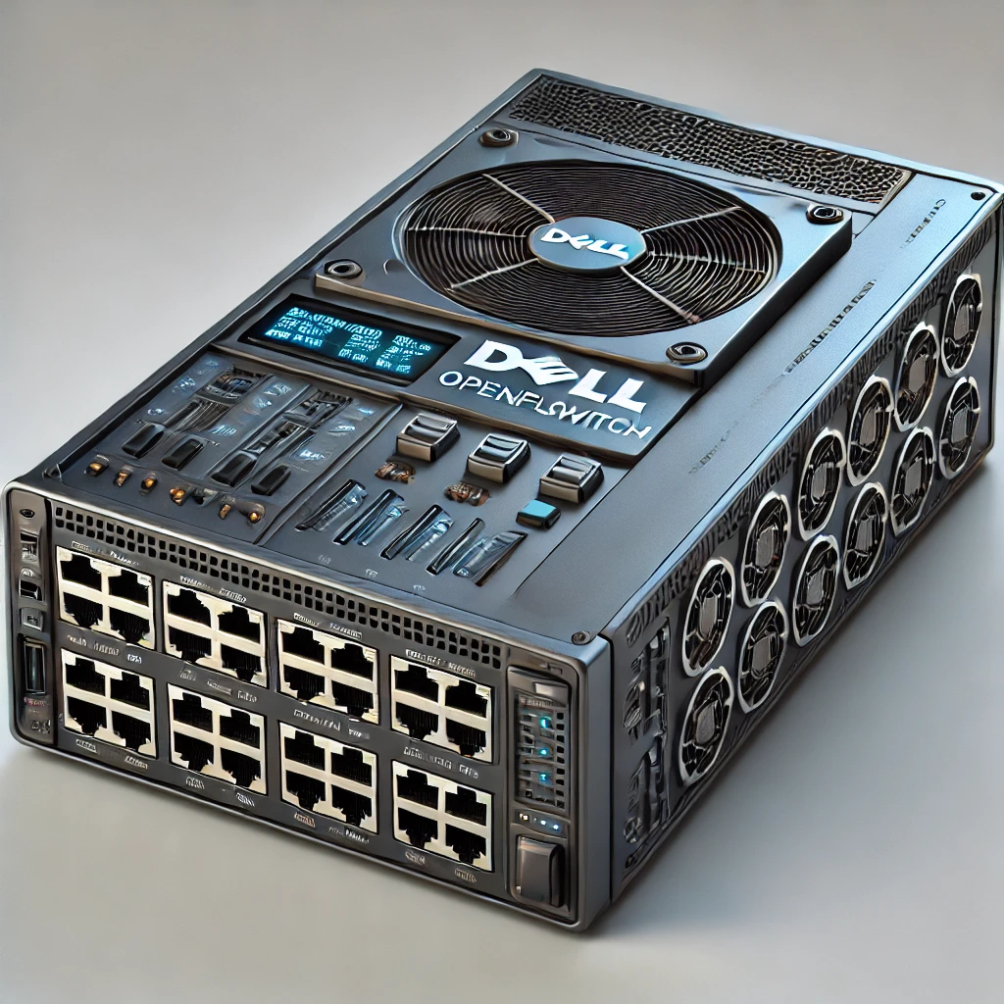
Key hardware OpenFlow switch manufacturers
DELL Switch

Slide 16
Key hardware OpenFlow switch manufacturers
NoviFlow:
  Focus: NoviFlow specializes in high-performance OpenFlow switches for demanding applications.
  Architecture: Their switches are designed for high throughput and low latency, often used in service provider networks and security applications. They emphasize programmable forwarding planes.
  Key Features: High-performance OpenFlow switches. Focus on network security and service chaining. Programmable forwarding plane with support for P4

Slide 17
Key hardware OpenFlow switch manufacturers
Barefoot Networks (Intel Tofino):
  Focus: Barefoot Networks, now part of Intel, is known for its Tofino programmable Ethernet switch chips.
  Architecture: Tofino chips are highly flexible and can be used to build switches that support OpenFlow and other SDN functionalities. They enable customized forwarding behavior.
  Key Features: Programmable Ethernet switch chips. High performance and flexibility. Used by various switch vendors to build OpenFlow-enabled hardware.

Slide 18
Comparison: ASIC-based Switches vs Software Switches
When comparing ASIC-based OpenFlow switches to software switches, ASIC-based switches generally outperform in terms of raw performance and high-throughput scenarios due to their dedicated hardware design.
While software switches offer greater flexibility and scalability for complex network configurations, often at the cost of slightly lower performance and potentially higher energy consumption depending on the implementation; however, advancements in software switch optimization are narrowing the gap in certain situations.

Slide 19
Comparison: ASIC-based Switches vs Software Switches
Performance:
  ASIC-based: Superior performance for high-speed packet forwarding due to specialized hardware designed for fast lookups in dedicated memory (like TCAM) within the ASIC chip, resulting in lower latency and higher throughput.
  Software-based: May experience performance bottlenecks due to reliance on general-purpose CPU processing for packet forwarding, potentially leading to higher latency and lower throughput, especially under heavy traffic.
Scalability:
  ASIC-based: Scalability can be limited by the fixed hardware capabilities of the ASIC, including the size of the TCAM table, which may not be easily expanded to accommodate large-scale networks.

Slide 20
Comparison: ASIC-based switches vs software switches
  Software-based: Offers greater scalability as the switch functionality is implemented in software, allowing for easier adaptation to changing network requirements and potentially adding new features by updating the software.
Energy Efficiency:
  ASIC-based: Can be more energy efficient due to optimized hardware design and specialized processing for packet forwarding, although this depends on the specific ASIC implementation.
  Software-based: May consume more power due to the need for CPU processing to handle packet forwarding, potentially leading to higher energy consumption, especially in large-scale deployments.

Slide 21
Use Case of Hardware OpenFlow switches
Hardware OpenFlow switches are utilized in carrier networks, enterprise data centers, and SD-WANs by acting as programmable network devices that allow a centralized controller to dynamically manage traffic flow through the network, enabling flexible routing, load balancing, and policy enforcement based on specific criteria, all through a software-defined approach, providing greater agility and automation compared to traditional static network configurations.

Slide 22
Use Case of Hardware OpenFlow switches
Carrier Networks:
Dynamic Traffic Engineering: OpenFlow switches allow carriers to dynamically reroute traffic based on network congestion, optimizing bandwidth usage across their network, especially in situations with fluctuating demand. Service Provisioning: By using OpenFlow, carriers can quickly provision new services and network slices for different customers with specific QoS requirements. Multi-vendor Interoperability: OpenFlow protocol enables seamless integration of devices from various vendors, providing flexibility in network design.

Slide 23
Use Case of Hardware OpenFlow switches
Enterprise Data Centers:
Virtual Machine Mobility: With OpenFlow, data center operators can easily migrate virtual machines across physical servers without requiring manual network configuration changes. Application-Aware Routing: By defining specific rules on the controller, network administrators can prioritize critical applications and direct traffic accordingly. Load Balancing: OpenFlow switches can distribute traffic evenly across multiple servers to maximize resource utilization.

Slide 24
Use Case of Hardware OpenFlow switches
SD-WAN:
Site-to-Site Connectivity: OpenFlow switches enable efficient routing between geographically dispersed branch offices by dynamically selecting the best path based on network conditions. Cloud Integration: SD-WANs leverage OpenFlow to seamlessly connect branch offices to cloud services with optimized routing based on application requirements. Policy Enforcement: SD-WAN controllers can utilize OpenFlow to enforce security policies at the network edge, filtering traffic according to specific criteria.

Slide 25
Challenges in OpenFlow Hardware Adoption
OpenFlow, while promising in its potential to revolutionize network management, faces several challenges in hardware adoption and integration:
Limited Hardware Support:
  Legacy Equipment: A significant portion of existing network infrastructure consists of legacy devices that do not support OpenFlow. Replacing this equipment is costly and disruptive, hindering widespread adoption.
  Vendor Lock-in: Some vendors are hesitant to fully embrace OpenFlow, as it may reduce their control over hardware and potentially decrease revenue from proprietary features.

Slide 26
Challenges in OpenFlow Hardware Adoption
  Feature Disparity: Even among devices that support OpenFlow, there can be inconsistencies in feature implementation, leading to interoperability issues and limiting the full potential of SDN.
Integration Complexity:
  Software Compatibility: Integrating OpenFlow-enabled hardware with existing network management software and controllers can be complex, requiring specialized expertise and potentially leading to compatibility issues.
  Network Stability: Introducing OpenFlow into a production network requires careful planning and testing to avoid disruptions and ensure network stability. Scalability Challenges:
  Scaling OpenFlow deployments to large and complex networks can be challenging, requiring robust controllers and efficient flow management mechanisms.

Slide 27
Challenges in OpenFlow Hardware Adoption
Performance Considerations:
  Latency: OpenFlow relies on communication between the control plane and data plane, which can introduce latency and potentially impact network performance, especially for time-sensitive applications.
  Processing Overhead: Handling OpenFlow rules and flows can impose a processing overhead on network devices, potentially affecting their forwarding capacity

Slide 28
Challenges in OpenFlow Hardware Adoption
Security Concerns:
  Centralized Control: The centralized nature of SDN can create a single point of failure and a potential target for attacks.
  Security Vulnerabilities: OpenFlow itself may have security vulnerabilities that could be exploited by malicious actors.
Management and Operational Challenges:
  Skill Gap: Managing OpenFlow-based networks requires specialized skills and knowledge, which may be lacking in existing network administration teams.
  Troubleshooting: Diagnosing and troubleshooting issues in OpenFlow networks can be more complex than in traditional networks.

Slide 29
Overcoming the Challenges
Hybrid Approaches: Combining OpenFlow with traditional networking protocols can allow for gradual migration and integration.
Standardization Efforts: Organizations like the Open Networking Foundation (ONF) are working to standardize OpenFlow and promote interoperability.
Software Advancements: Improvements in SDN controllers and management software are simplifying integration and operation.
Hardware Innovation: Vendors are developing more OpenFlow-enabled hardware with enhanced features and performance.

Slide 30
Conclusion
Hardware OpenFlow switches play a crucial role in modern networking by combining the flexibility of Software-Defined Networking (SDN) with the high performance of dedicated hardware. By leveraging OpenFlow, these switches enable centralized control, improved scalability, and efficient traffic management in enterprise data centers, carrier networks, and SD-WAN environments.
Compared to software-based alternatives, ASIC-powered OpenFlow switches offer superior performance, lower latency, and greater energy efficiency. However, challenges such as vendor interoperability, deployment complexity, and evolving OpenFlow standards remain key considerations.

Slide 31
REFERENCES
https://youtu.be/y99pjaqukg4?si=T2pzOHb1AaB-A20s. 05 feb 2025.
Arista EOS: https://www.arista.com/en/products/eosIntel Tofino https://www.intel.com/content/www/us/en/products/network-connectivity/programmable-ethernet-switch.html.
NoviFlow Solutions: https://noviflow.com/solutions/
Dell Networking: https://www.dell.com/en-us/work/shop/networking/switches/spd/networking-switches
HPE Aruba: https://www.arubanetworks.com/
PicOS: https://www.pica8.com/products/picos-network-operating-system

