Slide 1
CP 311: Internet Programming And Applications II
LECT_ONE

Slide 2

Introduction
What is Bootstrap?
Bootstrap is a sleek, intuitive, and powerful, mobile first front-end framework for faster and easier web development.
It uses HTML, CSS, and JavaScript
Bootstrap was developed by Mark Otto and Jacob Thornton
It was released as an open source product in August 2011 on GitHub.
Bootstrap is open source. It's hosted, developed, and maintained on GitHub.

Slide 3
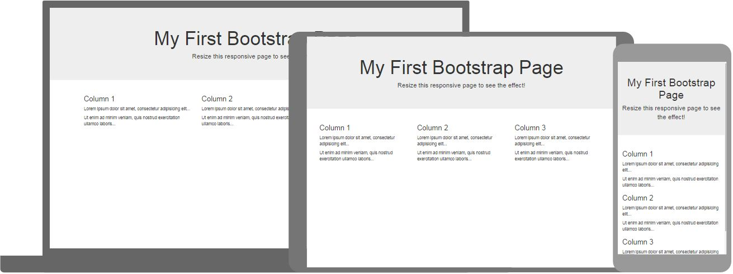
Introduction

Slide 4
Why Use Bootstrap?
Mobile first approach: Bootstrap framework consists of Mobile first styles throughout the entire library instead of them in separate files.
Browser Support: It is supported by all popular browsers.
Easy to get started: With just the knowledge of HTML and CSS anyone can get started with Bootstrap. Also the Bootstrap official site has a good documentation. https://getbootstrap.com/
Responsive design: Bootstrap's responsive CSS adjusts to Desktops, Tablets and Mobiles.

Slide 5
Environment Setup
You can download the latest version of Bootstrap from http://getbootstrap.com/
You can download the precompiled and minified versions of Bootstrap CSS, JavaScript, and fonts.

Slide 6
bootstrap containers
Bootstrap requires its elements to be wrapped in a container.
The .container class provides a responsive fixed width container
The .container-fluid class provides a full width container, spanning the entire width of the viewport

Slide 7

bootstrap containers

Slide 8
Bootstrap Grid System
In graphic design, a grid is a structure (usually two-dimensional) made up of a series of intersecting straight (vertical, horizontal) lines used to structure content.
It is widely used to design layout and content structure in print design.
In web design, it is a very effective method to create a consistent layout rapidly and effectively using HTML and CSS.

Slide 9
Bootstrap Grid System
What is Bootstrap Grid System?
Bootstrap includes a responsive, mobile first fluid grid system that appropriately scales up to 12 columns as the device or viewport size increases.
Bootstrap 3 is mobile first in the sense that the code for Bootstrap now starts by targeting smaller screens like mobile devices, tablets, and then “expands” components and grids for larger screens such as laptops, desktops

Slide 10
Bootstrap Grid System
What is Bootstrap Grid System?
Bootstrap includes a responsive, mobile first fluid grid system that appropriately scales up to 12 columns as the device or viewport size increases.
Bootstrap 3 is mobile first in the sense that the code for Bootstrap now starts by targeting smaller screens like mobile devices, tablets, and then “expands” components and grids for larger screens such as laptops, desktops

Slide 11
Bootstrap Grid System
Grid systems are used for creating page layouts through a series of rows and columns that house your content.
Rows must be placed within a .container class for proper alignment and padding.
Use rows to create horizontal groups of columns.
Content should be placed within columns, and only columns may be immediate children of rows.

Slide 12
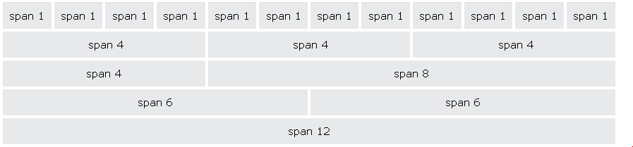
Bootstrap Grid System

Slide 13
Grid Classes
xs (for phones - screens less than 768px wide)
sm (for tablets - screens equal to or greater than 768px wide)
md (for small laptops - screens equal to or greater than 992px wide)
lg (for laptops and desktops - screens equal to or greater than 1200px wide)

Slide 14
BASIC GRID STRUCTURE
<div class="container">
<div class="row">
<div class="col-*-*"></div>
<div class="col-*-*"></div>
</div>
<div class="row">...</div>
</div>
<div class="container">....

Slide 15
BASIC GRID STRUCTURE (Example)
<div class="row">
<div class="col-sm-4">.col-sm-4</div>
<div class="col-sm-4">.col-sm-4</div>
<div class="col-sm-4">.col-sm-4</div>
</div>

Slide 16
Bootstrap CSS Overview
Bootstrap makes use of certain HTML elements and CSS properties that require the use of the HTML5 doctype
Since Bootstrap has become mobile first. It means mobile first styles can be found throughout the entire library instead of in separate files.
You need to add the viewport meta tag to the<head> element, to ensure proper rendering and touch zooming on mobile devices.

Slide 17
Bootstrap CSS Overview
<meta name="viewport" content="width=device-width, initial-scale=1.0">
width property controls the width of the device. Setting it to device-width will make sure that it is rendered across various devices (mobiles, desktops, tablets...) properly.
initial-scale=1.0 ensures that when loaded, your web page will be rendered at a 1:1 scale, and no zooming will be applied out of the box.

Slide 18
Bootstrap Typography/Text
Bootstrap's global default font-size is 14px, with a line-height of 1.428.
By default, Bootstrap will style the HTML headings (<h1> to <h6>) in the following way:
<div class="container">
<h1>h1 Bootstrap heading (36px)</h1>
<h2>h2 Bootstrap heading (30px)</h2>
<h3>h3 Bootstrap heading (24px)</h3>
<h4>h4 Bootstrap heading (18px)</h4>
<h5>h5 Bootstrap heading (14px)</h5>
<h6>h6 Bootstrap heading (12px)</h6>
</div>

Slide 19
Bootstrap Typography
In Bootstrap the HTML <small> element is used to create a lighter, secondary text in any heading:
<div class="container">
<h1>h1 heading <small>secondary text</small></h1>
<h2>h2 heading <small>secondary text</small></h2>
<h3>h3 heading <small>secondary text</small></h3>
<h4>h4 heading <small>secondary text</small></h4>
<h5>h5 heading <small>secondary text</small></h5>
<h6>h6 heading <small>secondary text</small></h6>
</div>

Slide 20
Bootstrap Typography
In Bootstrap the HTML <small> element is used to create a lighter, secondary text in any heading:
<div class="container">
<h1>h1 heading <small>secondary text</small></h1>
<h2>h2 heading <small>secondary text</small></h2>
<h3>h3 heading <small>secondary text</small></h3>
<h4>h4 heading <small>secondary text</small></h4>
<h5>h5 heading <small>secondary text</small></h5>
<h6>h6 heading <small>secondary text</small></h6>
</div>

Slide 21
Bootstrap Tables
A basic Bootstrap table has a light padding and only horizontal dividers.
The .table class adds basic styling to a table:

Slide 22
<div class="container">
<table class="table">
<thead>
<tr>
<th>Firstname</th>
<th>Lastname</th>
<th>Email</th>
</tr>
</thead>
<tbody>
<tr>
<td>John</td>
<td>Doe</td>
<td>john@example.com</td>
</tr>
<tr>
<td>Mary</td>
<td>Moe</td>
<td>mary@example.com</td>
</tr>
</tbody>
</table>
</div>

Slide 23
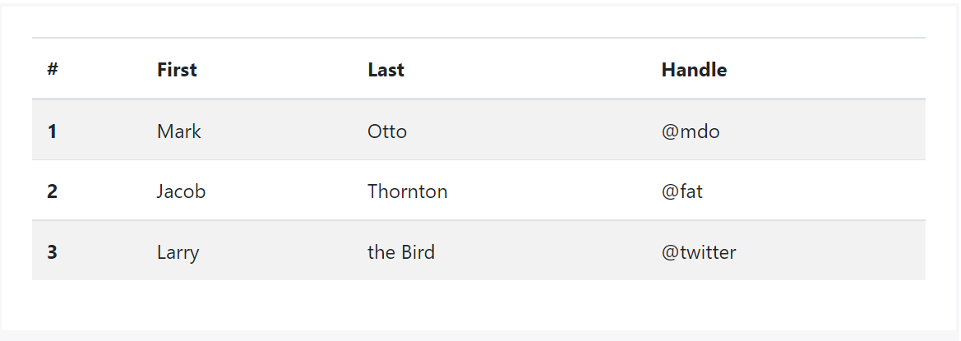
STRIPED TABLE
By adding the .table-striped class, you will get stripes on rows within the <tbody>

Slide 24
<table class="table table-striped">
<thead>
<tr>
<th>Name</th>
<th>Region</th>
<th>District</th>
</tr>
</thead>
<tbody>
<tr>
<td>Siphael</td>
<td>Betuel</td>
<td>Dodoma</td>
</tr>
<tr>
<td>Juma</td>
<td>Ally</td>
<td>Mwanza</td>
</tr>
</tbody>
</table>
</html>

Slide 25
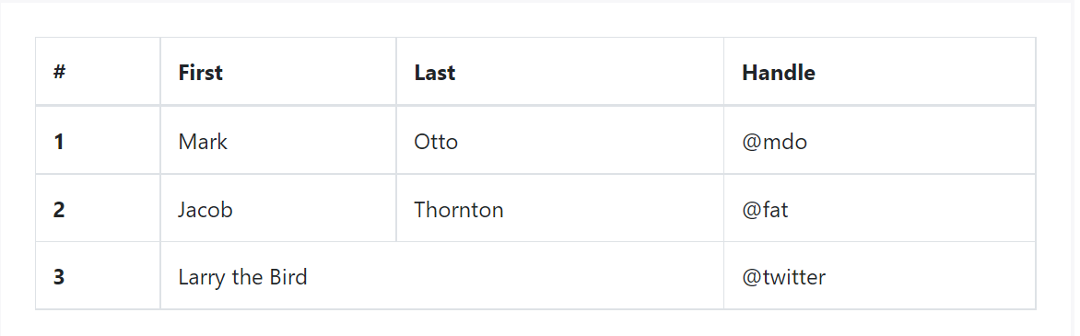
BORDERED TABLE
By adding the .table-bordered class, you will get borders surrounding every element and rounded corners around the entire table.

Slide 26
<table class="table table-bordered">
<thead>
<tr>
<th>Name</th>
<th>Region</th>
<th>District</th>
</tr>
</thead>
<tbody>
<tr>
<td>Siphael</td>
<td>Betuel</td>
<td>Dodoma</td>
</tr>
<tr>
<td>Juma</td>
<td>Ally</td>
<td>Mwanza</td>
</tr>
</tbody>
</table>
</html>

Slide 27
HOVER TABLE
By adding the .table-hover class, a light gray background will be added to rows while the cursor hovers over them,

Slide 28
<table class="table table-hover">
<thead>
<tr>
<th>Name</th>
<th>Region</th>
<th>District</th>
</tr>
</thead>
<tbody>
<tr>
<td>Siphael</td>
<td>Betuel</td>
<td>Dodoma</td>
</tr>
<tr>
<td>Juma</td>
<td>Ally</td>
<td>Mwanza</td>
</tr>
</tbody>
</table>
</html>

Slide 29
Bootstrap Forms
With bootstrap you can easily create forms using simple html.
Bootstrap provides you with following types of form layouts:
    Vertical (default) form
    Inline form
    Horizontal form

Slide 30
Bootstrap Forms(Vertical Form)
The basic form structure comes with Bootstrap; individual form controls automatically receive some global styling.
To create a basic form do the following:
      Add a role form to the parent <form> element.
      Wrap labels and controls in a <div> with class .form-group. This is needed for optimum spacing.
      Form-control automatically receives some global style
      Add a class of .form-control to all textual <input>, <textarea>, and <select> elements

Slide 31
Bootstrap Forms(Vertical Form)
<form role=“form”>
<div class="form-group">
<label for="email">Email address:</label>
<input type="email" class="form-control" id="email">
</div>
<div class="form-group">
<label for="pwd">Password:</label>
<input type="password" class="form-control" id="pwd">
</div>
<div class="checkbox">
<label><input type="checkbox"> Remember me</label>
</div>
<button type="submit" class="btn btn-default">Submit</button>
</form>

Slide 32
Bootstrap Forms(INLINE FORM)
To create a form where all of the elements are inline, left aligned and labels are alongside, add the class .form inline to the <form> tag.

Slide 33
Bootstrap Forms(INLINE FORM)
<form class="form-inline" action=“##">
<div class="form-group">
<label for="email">Email address:</label>
<input type="email" class="form-control" id="email">
</div>
<div class="form-group">
<label for="pwd">Password:</label>
<input type="password" class="form-control" id="pwd">
</div>
<div class="checkbox">
<label><input type="checkbox"> Remember me</label>
</div>
<button type="submit" class="btn btn-default">Submit</button>
</form>

Slide 34
Bootstrap Forms(Horizontal form)
A horizontal form means that the labels are aligned next to the input field (horizontal) on large and medium screens.
On small screens (767px and below), it will transform to a vertical form (labels are placed on top of each input).
Additional rules for a horizontal form:
    Add class .form-horizontal to the <form> element
    Add class .control-label to all <label> elements

Slide 35
Bootstrap Forms(Horizontal form)
<form class="form-horizontal" action=“##">
<div class="form-group">
<label class="control-label” for="email">Email address:</label>
<input type="email" class="form-control" id="email">
</div>
<div class="form-group">
<label class="control-label” for="pwd">Password:</label>
<input type="password" class="form-control" id="pwd">
</div>
<div class="checkbox">
<label><input type="checkbox"> Remember me</label>
</div>
<button type="submit" class="btn btn-default">Submit</button>
</form>

Slide 36
Bootstrap Form Inputs
Bootstrap supports the following form controls:
input
textarea
checkbox
radio
select

Slide 37
Bootstrap Form Inputs
Bootstrap supports all the HTML5 input types:
text, password,
datetime,
datetime-local, date, month, time, week,
number,
email, url, search,
tel, and color.

Slide 38
Bootstrap Form Inputs(text and pass)
<div class="form-group">
<label for="usr">Name:</label>
<input type="text" class="form-control" id="usr">
</div>
<div class="form-group">
<label for="pwd">Password:</label>
<input type="password" class="form-control" id="pwd">
</div>

Slide 39
Bootstrap Form Inputs(text area)
<div class="form-group">
<label for="comment">Comment:</label>
<textarea class="form-control" rows="5" id="comment"></textarea>
</div>

Slide 40
Bootstrap Form Inputs(check box)
Use a wrapper element with class="form-check" to ensure proper margins for labels and checkboxes.
Add the .form-check-label class to label elements
Add .form-check-input to style checkboxes properly inside the .form-check container.

Slide 41
Bootstrap Form Inputs(check box)
<div class=“form-check">
<label class=“form-check-label” for =“op1”>
<input type="checkbox“ class=“form-check-input” value="">Option 1</label>
<div class=“form-check">
<label class=“form-check-label” for =“op2”>
<input type="checkbox“ class=“form-check-input” value="">Option 2</label>
</div>

Slide 42
Bootstrap Form Inputs(radio button)
<div class="radio">
<label><input type="radio" name="optradio" checked>Option 1</label>
</div>
<div class="radio">
<label><input type="radio" name="optradio">Option 2</label>
</div>
<div class="radio disabled">
<label><input type="radio" name="optradio" disabled>Option 3</label>
</div>

Slide 43
Bootstrap Buttons
Bootstrap provides different styles of buttons:
.btn
.btn-default
.btn-primary
.btn-success
.btn-info
.btn-warning
.btn-danger
.btn-link

Slide 44
Bootstrap Buttons
<button type="button" class="btn">Basic</button>
<button type="button" class="btn btn-default">Default</button>
<button type="button" class="btn btn-primary">Primary</button>
<button type="button" class="btn btn-success">Success</button>
<button type="button" class="btn btn-info">Info</button>
<button type="button" class="btn btn-warning">Warning</button>
<button type="button" class="btn btn-danger">Danger</button>
<button type="button" class="btn btn-link">Link</button>

Slide 45
Bootstrap Buttons(Button Sizes)
<button type="button" class="btn btn-primary btn-lg">Large</button>
<button type="button" class="btn btn-primary">Normal</button>
<button type="button" class="btn btn-primary btn-sm">Small</button>
<button type="button" class="btn btn-primary btn-xs">XSmall</button>

Slide 46
Bootstrap Buttons(Block Level Buttons)
A block level button spans the entire width of the parent element.
<button type="button" class="btn btn-primary btn-block">Button 1</button>

Slide 47
Bootstrap Images
Bootstrap provides three classes that can be used to apply some simple styles to images:
    .img-rounded: adds border-radius:6px to give the image rounded corners.
    .img-circle: makes the entire image round by adding border-radius:500px.
    .img-thumbnail: adds a bit of padding and a gray border:

Slide 48
Bootstrap Images
<img src="cat.jpg" class="img-rounded" alt=“cat">
<img src="cat.jpg" class="img-circle" alt="Cat">
<img src="cat.jpg" class="img-thumbnail" alt="Cat">

Slide 49
Bootstrap Helper Classes
Bootstrap includes a number of helper classes for a certain purpose.
Helpers are bootstrap classes that make certain customization as quickly as possible.
These classes are built to offer a single purpose and reduce CSS frequency of repeated rules.
Bootstrap comes with good CSS structure and the framework was established to promote best coding practices with the concept of DRY (Don’t Repeat Yourself)

Slide 50
Bootstrap Helper Classes
Close icon
Use the generic close icon for dismissing content like modals and alerts.
Use the class close to get the close icon.
<p>Close Icon Example
<button type="button" class="close" aria-hidden="true">
&times;
</button>
</p>

Slide 51
Bootstrap Helper Classes
Carets
Use carets to indicate dropdown functionality and direction.
To get this functionality use the class caret with a element.
<p>Caret Example
<span class="caret"></span>
</p>

Slide 52
Bootstrap Glyphicons
Glyphicons are icon fonts which you can use in your web projects.
Glyphicons Halflings are not free and require licensing, however their creator has made them available for Bootstrap projects free of cost.
It is recommended, as a thank you, we ask you to include an optional link back to GLYPHICONS whenever practical. — Bootstrap Documentation

Slide 53
Bootstrap Modal
A model is a child window that is layered over its parent window.
Typically, the purpose is to display content from a separate source that can have some interaction without leaving the parent window.
Child windows can provide information, interaction, or more.

Slide 54
END

