Slide 1
DATABASE SECURITY
PREPARED By Amina abdul
PRESENTED BY: DR. JABHERA AMTOGORO

Slide 2
AREA TO BE COVERED
Introduction to database
Database security
Methods to secure a database
Database Access Control
Database Auditing
Data Encryption
Backups and Restoration of Data

Slide 3
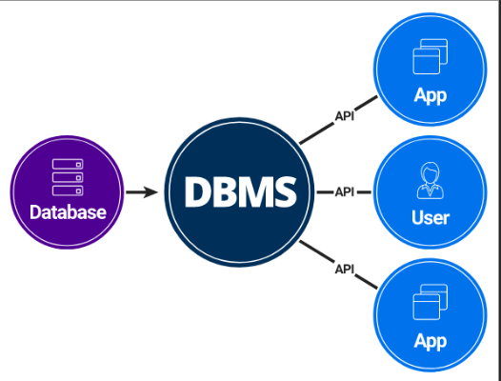
Introduction to database
A database is an organized collection of structured information, or data, typically stored electronically in a computer system.
A database is usually controlled by a database management system (DBMS). Together, the data and the DBMS, along with the applications that are associated with them, are referred to as a database system, often shortened to just database.
Sample Diagram of database system.

Slide 4

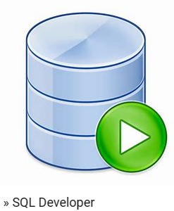



Some of DBMS tools
Toad by Quest
SQL Developer
SQL Navigator
DBVisualizer
Solarwinds Database Performance Analyzer

Slide 5
Introduction to database Cont..
We have two main types of databases, which are Relational database(SQL) and Non Relational database (NoSQL).
Relational Database(SQL)
In a relational database management system (RDBMS), the relationship between data is relational and data is stored in tabular form of columns and rows. Each column of a table represents an attribute and each row in a table represents a record. Each field in a table represents a data value.
Structured Query Language (SQL) is the language used to query RDBMS, including inserting, updating, deleting, and searching records. Relational databases work on each table that has a key field that uniquely indicates each row.
Relational databases are the most popular and widely used databases. Some of the popular RDBMS are Oracle, SQL Server, MySQL, SQLite, and IBM DB2.

Slide 6
Introduction to database Cont..
NoSQL Databases
NoSQL databases are databases that do not use SQL as their primary data access language. Graph database, network database, object database, and document databases are common NoSQL databases.
NoSQL database does not have predefined schemas, which makes NoSQL databases a perfect candidate for rapidly changing development environments. It also allows developers to make changes without affecting applications. Can be categorized into Column, Document, Graph, Key-value, and Object databases.
Popular NoSQL database are Cosmos DB, ArangoDB, Couchbase Server, CouchDB, Amazon DocumentDB, MongoDB, CouchBase, Elasticsearch, Informix, SAP HANA.

Slide 7
Can you list 3 database vendors worldwide??

Slide 8
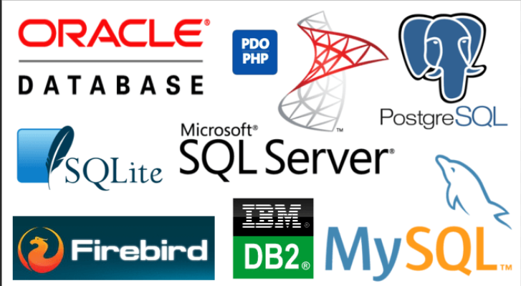
Different database VENDORS

Slide 9
INSTALLATION OF DATABASE
In order to install database, you have to install the OS for your database. You can install database on Linux servers, or windows servers.
After installing OS of your choice successful, you can download the database software from the official websites such as oracle website for oracle database, Microsoft for MS SQL database, MySQL for MySQL database, PostgreSQL and others.
Note: The database software will be downloaded as per OS of your choice. Ie oracle database software for Linux.
Oracle Database 19c Download for Linux x86-64 link for oracle database software

Slide 10
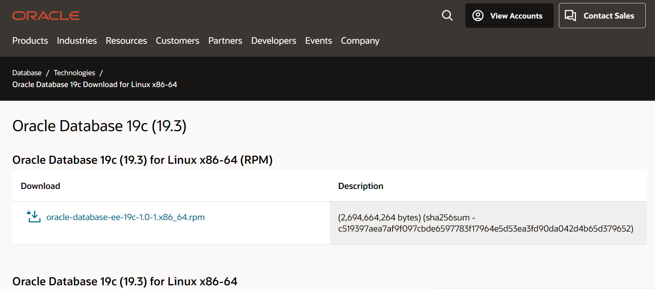

Slide 11
USEFUL Links for STEP BY STEP INSTALLATION OF ORACLE DATABASE ON LINUX AND WINDOWS SERVER
ORACLE-BASE - Oracle Database 19c Installation On Oracle Linux 7 (OL7)
Installation of Oracle Database 19c On Windows – KTEXPERTS
By following this two link you will be able to install oracle 19c successful on Linux machine and Windows Server Machine.
For student, I encourage you to install virtual Machines such as OVM or VMware as your own lab and practice this!!!

Slide 12
DATABASE SECURITY

Slide 13
WHAT IS DATABASE SECURITY
Database Security refers to the collective measures used to protect and secure a database or database management software from illegitimate use and malicious threats and attacks.
Database security, protects the confidentiality, integrity and availability (CIA) of an organization databases.
The security Information typically follows the CIA model. Confidentiality requires that only authorized users have access to information in order to preserve the privacy of individuals, business intellectual property, and national security efforts.
With the growth of social media and online business due to the Internet, maintaining confidentiality involves using appropriate encryption techniques as well as user authorization, identification, and authentication procedures.

Slide 14
Database Security Cont..
Integrity
its requires that only authorized users be allowed to modify data, thus maintaining data consistency and trustworthiness. If data is incorrect, it is no longer useful. Incorrect data can also be harmful to individuals (such as wrong data on a credit report) and organizations (such as invalid financial reports).
Availability
its requires that information be accessible by authorized users when needed. Security attacks against an organization can cause business services to become unavailable, leading to violations of service level agreements that are critical to business operations.

Slide 15
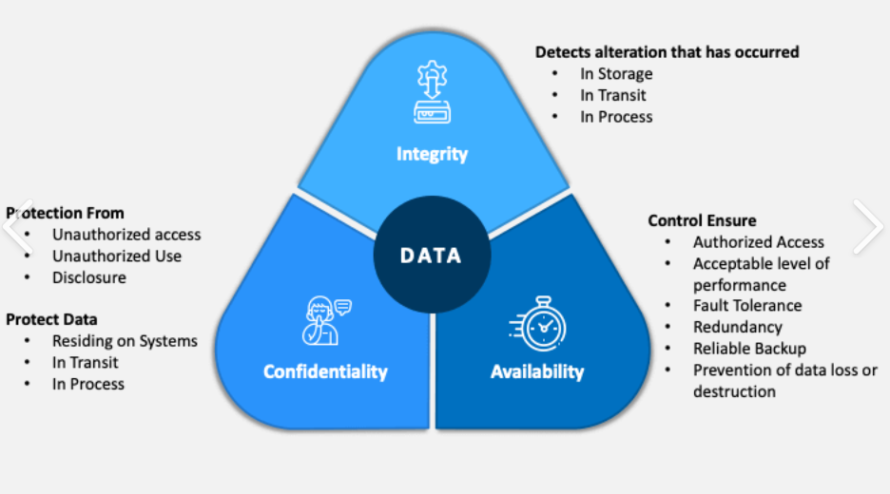

Slide 16
MOST COMMON DATABASE VULNERABILITY
Poor Encryption and Data Breach.
SQL Injection.
Audit Trail Tracking.
Database Backups.
Denial of service.
Missing Security patches.
Poor users and group privileges management.
Poor Passwords resources.

Slide 17
METHODS TO SECURE A DATABASE
Avoid using default ports.
Using Firewalls.
Using separate servers.
Users Authentication
Database Access control
Database Auditing
Encryption
Backups
Apps and database up to date

Slide 18
DEFAULT DATABASE PORTS
Each Database has its own default port. If a DBA install database using defaults port made an attacker task easy, because once the attacker scan the network will identify the database running on that machine.
As one of the methods to secure a database, a DBA should avoid using defaults ports.
Default ports for MS SQL, Oracle, MySQL, PostgreSQL and MongoDB database are (1433,4022,135,1434), 1521, 3306, 5432 and 27017 respectively.

Slide 19
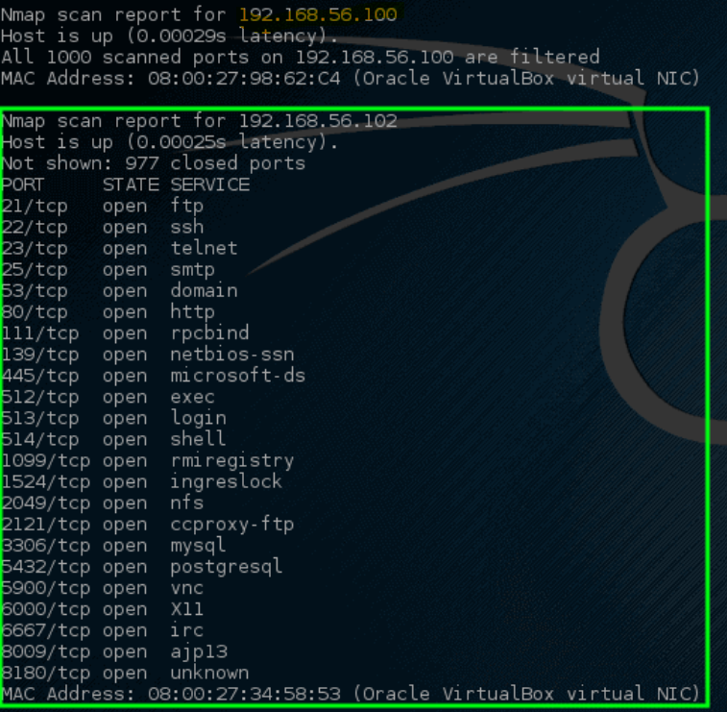
SAMPLE OF NMAP OUTPUT

Slide 20
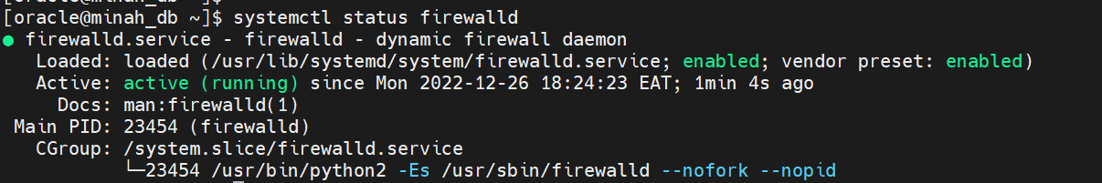
USING FIREWALL
Firewall can be used in order to allow only allowed range of IP address to connect to the database servers. Eg in Linux server, server firewall can be enables and use IP table to allow only few IP range to connect.
The following snapshot shows the status of firewall on Linux server

Slide 21
USING SEPARATE SERVERS
For secure database system, its better to separate database servers with application servers. This will increase data security and improve performance. Once an attacker get access to application servers wont be able to harm database server.
But on single node application and database, both database and application could be harmed/destroyed by an attacker.
Also on high availability of service multiple node are installed on different server and application is configured only to point the virtual IP , Once attacker get access to one node DBA could easy disconnect the server but application and business wont notice any changes.

Slide 22
UP To date database and application
Each database has many versions. In oracle we have oracle 11g, 12c, 18c, 19c and 21c. But starting 12c and below version are already out dated and are no longer supported by oracle. This means no any security patches which will be released by the vendor. For organizations which are still using those oracle versions are in high risk of being attacked.
Security Patches most are released in January, April, July and October for Oracle databases and MySQL database, while in MS SQL are release after every two months (60 days).
As DBA you have to make sure all security patches are applied once are stable in order to secure the databases.

Slide 23
USER AUTHENTICATION
Users can be authenticated in a number of different ways before they are allowed to create a database session.
In database authentication, you can define users such that the database performs both identification and authentication of users.
In external authentication, you can define users such that authentication is performed by the operating system or network service. Alternatively, you can define users such that they are authenticated by the Secure Sockets Layer (SSL).

Slide 24
USER AUTHENTICATION Cont..
Passwords are one of the basic forms of authentication. A user must provide the correct password when establishing a connection to prevent unauthorized use of the database.
In this way, users attempting to connect to a database can be authenticated by using information stored in that database.
Passwords are assigned when users are created, a database can store a user's password in the data dictionary in an encrypted format.
Useful link: https://docs.oracle.com/cd/B14117_01/network.101/b10777/authuser.html

Slide 25
USER AUTHENTICATION Cont..
A number of steps can strengthen the basic password feature and provide greater control over database security:
Password management policy can be controlled by DBAs through user profiles.
The DBA can establish standards for password complexity, such as minimum password length.
Passwords should be words that cannot be found in the dictionary. They should not consist of people's names or birthdates.
Passwords can be timed out, expiring after a certain amount of time. This requires users to change the value periodically.
Reuse of passwords can be prohibited for a certain amount of time.
When a particular user exceeds a designated number of failed login attempts, the server can automatically lock that user's account.

Slide 26
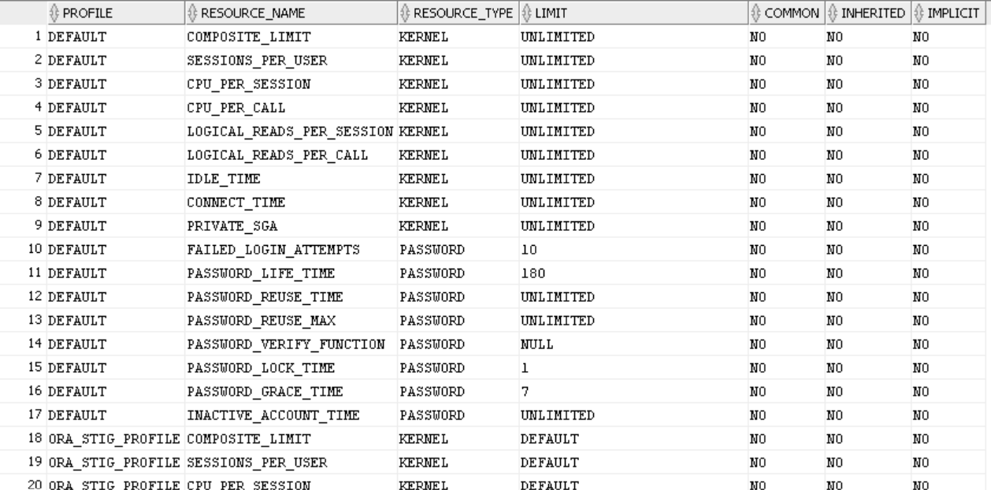
USER PROFILE SNAPSHOT ON PASSWORD RESOURCES

Slide 27
DATABASE AUDITING
Audit Trails records all access to the database, keeping information about the user who requested the access, the operation performed, the workstation used, the exact time of occurrence, the data item, its old value, and its new value, if any.
The audit trail can therefore uncover the sources of suspicious operations on the database, even if they are performed by authorized users, such as disgruntled employees. Triggers can also be used to set up an audit trail for a table, recording all changes, the time they were made, and the identity of the user who made them.
Tools for database auditing are Oracle vault, Audit trails, Profiler (Microsoft)
https://docs.oracle.com/cd/E14472_01/doc.102/e14460/toc.html

Slide 28
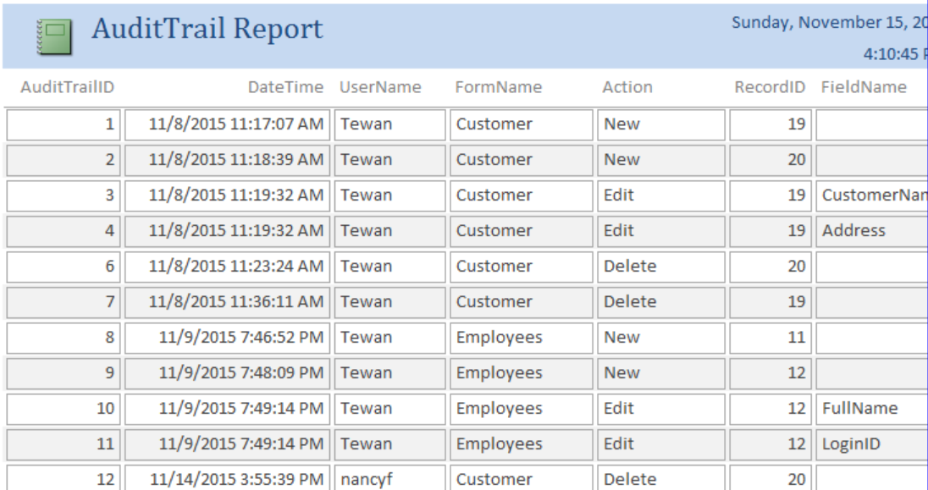
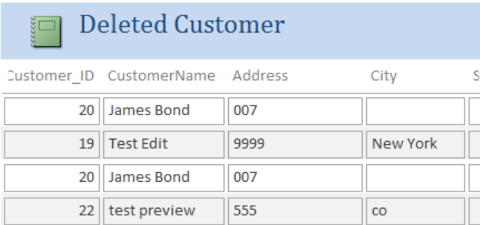

Slide 29
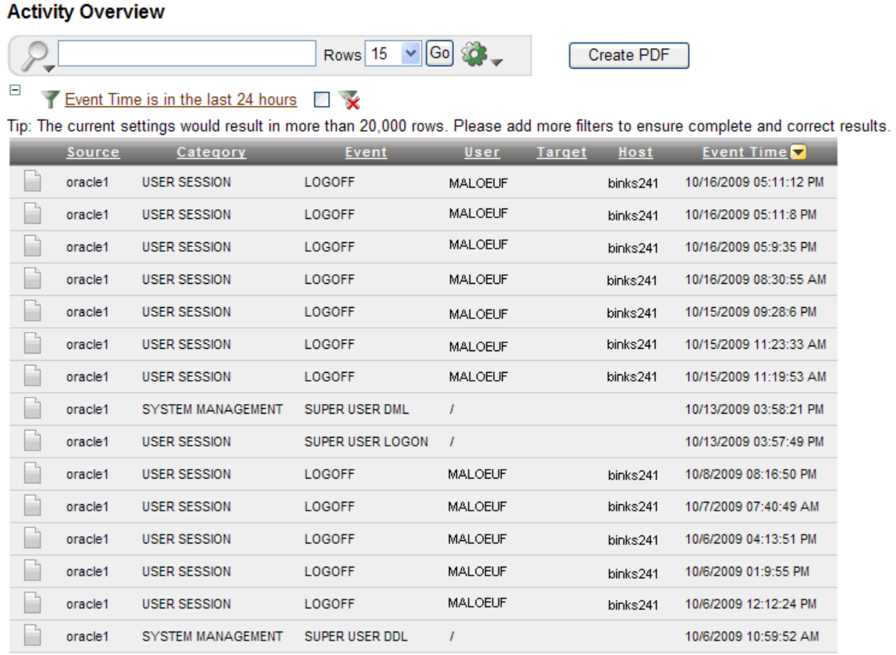

Slide 30
DATA ENCRYPTION
Data can be stored in the database in encrypted form. Only the database management system can unscramble the data, so that anyone who obtains data by any other means will receive jumbled data. When authorized users access the information properly, the DBMS retrieves the data and decodes it automatically.
Encryption should also be used whenever data is communicated to other sites, so that wire tappers will also receive scrambled data. Encryption requires a cipher system , which consists of the following components:
An encrypting algorithm , which takes the normal text ( plaintext ) as input, performs some operations on it, and produces the encrypted text ( ciphertext ) as output
An encryption key , which is part of the input for the encrypting algorithm and is chosen from a very large set of possible keys
A decrypting algorithm , which operates on the ciphertext as input and produces the plaintext as output
A decryption key , which is part of the input for the decrypting algorithm and is chosen from a very large set of possible keys

Slide 31
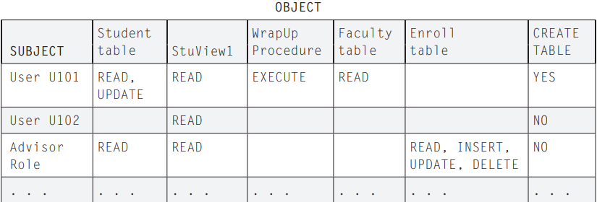
DATABASE ACCESS CONTROL
Database access control is the process of making sure that data or other resources are accessed only in authorized ways. In planning access, the DBA might use an access control matrix for the database.

Slide 32
DATABASE ACCESS CONTROL CONT…
DBA can grant data access to others or to revoke access. Some systems allow the DBA to delegate some of this power, granting users the power to authorize other users to perform operations on the database. However, having many such authorizers can be extremely dangerous. Since authorizers can create other authorizers, the situation can get out of hand very quickly, making it difficult for the DBA to revoke authorizations.
Using Views for Access control in database
Views is a virtual table whose contents are defined by a query. Like a table, a view consists of a set of named columns and rows of data. Unless indexed, a view does not exist as a stored set of data values in a database.
A view can be used to control access to various database objects on users.

Slide 33
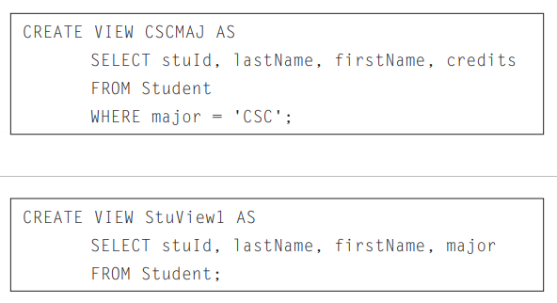
DATABASE ACCESS CONTROL CONT…

Slide 34
roleS in database
Roles are groupings of privileges that you can use to create different levels of database access. For example, you can create a role for application developers that enable users to create tables and programs.
You can grant privileges and roles to other users only when you possess the necessary privilege.
The granting of roles and privileges starts at the administrator level.
At database creation, the administrative user SYS is created and granted all system privileges and predefined Oracle roles.
User SYS can then grant privileges and roles to other users and also grant those users the right to grant specific privileges to others.

Slide 35
DATABASE ACCESS CONTROL CONT…
DEMONSTRATION ….

Slide 36
BACKUP
Database backup is the process of backing up the operational state, architecture and stored data of database software. It enables the creation of a duplicate instance or copy of a database in case the primary database crashes, corrupted or lost.
The most common backup types are a full backup, incremental backup and differential backup. Other backup types include synthetic full backups and mirroring.
Backup of database is also among the methods of securing database, it increase data availability which in turn results to Business continuity. As one of Government condition to each organization, is to ensure continuity of the business by having different plans on data availability through backup and Disaster recovery.

Slide 37
DATA HIGH AVAILABILITY
A High Availability (HA) Database is a database system designed to operate continuously with no interruptions in service. So database errors and failures must be handled by automatically failing over to redundant nodes when problems occur.
High availability database design requires enough nodes to properly distribute the load, and an appropriate consistency requirement. The more nodes, and the stronger the consistency model, the more latency is possible in the system.

Slide 38
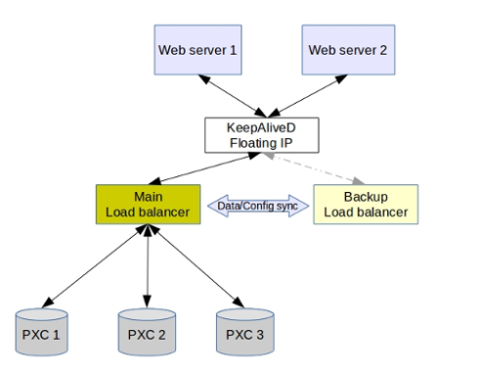
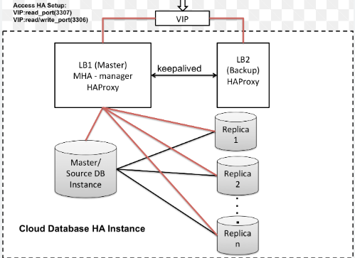
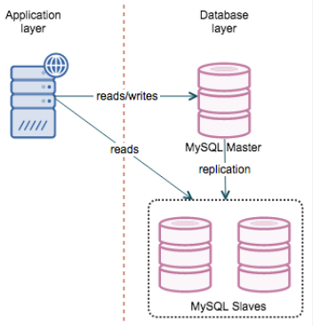

Slide 39
DISASTER RECOVERY
Is the activities that need to be done to restore the database in the event of a fire, earthquake, vandalism, or other catastrophic events.
A plan for disaster recovery can include one or more of the following:
A site to be used in the event of an emergency
A different machine on which to recover the database
Offsite storage of either database backups, tablespace backups, or both, as well as archived logs.
This is called secondary site. Can be used when primary site is inaccessible.

Slide 40
DISASTER RECOVERY CONT…
Different technology such as Dell EMC, oracle Data guard, Peer-to-peer remote copy are used to copy replicate data from primary site to secondary site.
Data can be copied from storage to storage by using Dell EMC or object to object using oracle data guard in oracle databases.
The organizations suppose to perform DR test each quarter in order to ensure the secondary site is working fine and incase of any emergency to the primary site, it will be able to handle everything.

Slide 41
USEFUL LINKS
https://www.ibm.com/docs/en/db2/11.5?topic=recover-disaster-recovery
https://www.vmware.com/topics/glossary/content/disaster-recovery.html
https://www.oracle.com/cloud/backup-and-disaster-recovery/
Link for oracle education: https://education.oracle.com/
Data access control: https://www.datasunrise.com/professional-info/what-is-access-control/
Roles: https://learn.microsoft.com/en-us/sql/relational-databases/security/authentication-access/database-level-roles?view=sql-server-ver16
https://docs.oracle.com/cd/B16351_01/doc/server.102/b14196/users_secure002.html

Slide 42
ANY QUESTION???

Slide 43
THANK YOU!!!

