Slide 1
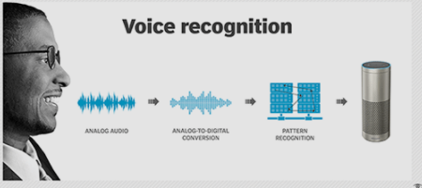
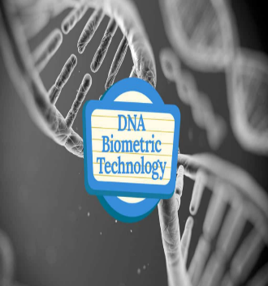

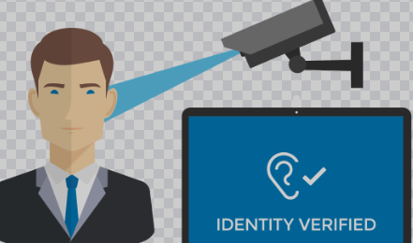
THE UNIVERSITY OF DODOMA
COLLEGE OF INFORMATICS AND VIRTUAL EDUCATION
DEPARTMENT OF CSE
IA 314: Biometric Security
Lecture 5-7:
5.Voice/Speaker and Retina Recognition
6. DNA-based Biometrics & Palmprint Recognition
7. Ear Biometrics, Hand Geometry (Shape) Biometrics, Key Stroke Biometrics, and Gait Biometrics

Slide 2
IA 314
Instructor: Dr. Noe Elisa (Lecturer);
Office: BG13;
Lecture Hours: Friday 08:00-10:00 LRA102;
Tutorial Hours: Monday 13:00 - 14:00 LRA102;
Practical Hours: Tuesday 12:00 - 14:00 MULT_LAB;
Consultation: Thursday 14:00am-16:00 pm.

Slide 3
Voice recognition
Voice recognition can identify and distinguish voices using automatic speech recognition (ASR) software programs.
voice recognition aims to identify and authenticate individuals based on their unique vocal characteristics.
Speech recognition focuses on converting spoken language into written text, enabling transcription and text-based analysis.

Slide 4
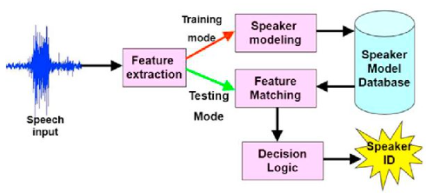
How might computers do Voice Recog?
Speaker Recognition System

Slide 5
Attacks on Speech Recognition Systems
replay attacks,
impersonation attacks,
speech synthesis attacks, and
voice conversion attacks.

Slide 6
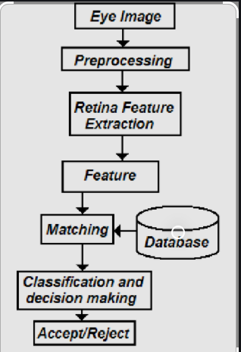
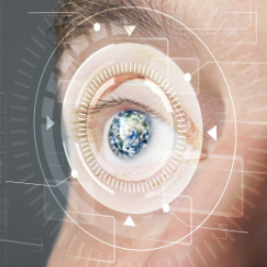
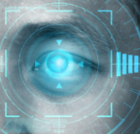
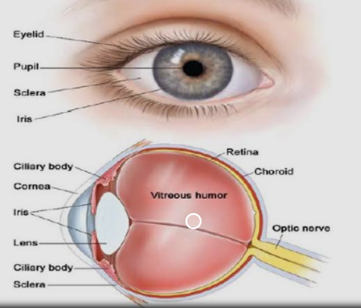
Retina scan/Identification/Recognition

Slide 7
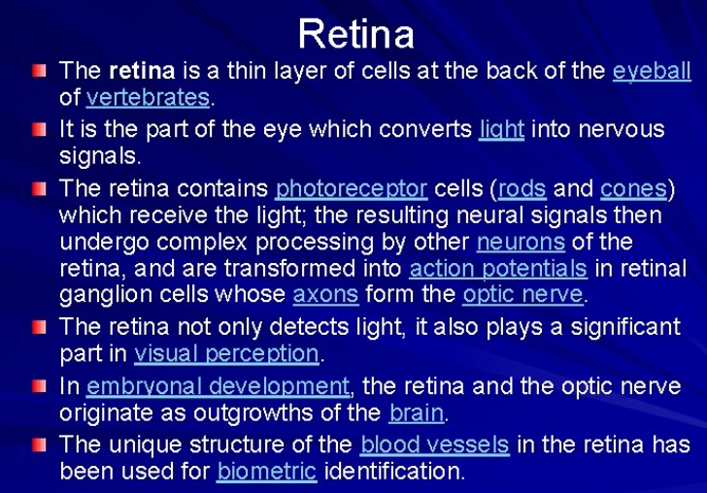

Slide 8
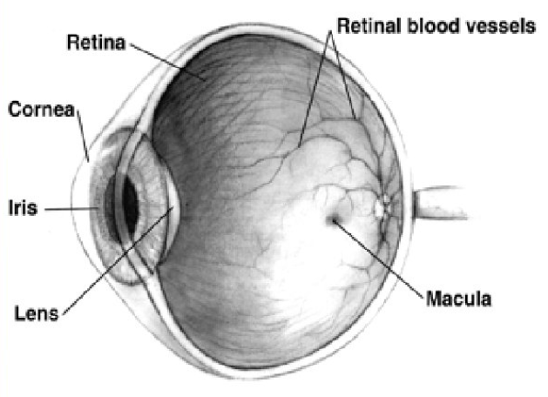
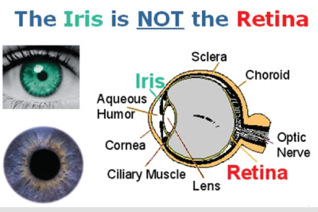
Because of the complex structure of the capillaries that supply the retina with blood, each person’s retina is unique.
The network of blood vessels in the retina is so complex that even identical twins do not share a similar pattern.
Although retinal patterns may be altered in cases of diabetes, glaucoma or retinal degenerative disorders, the retina typically remains unchanged from birth until death.
A biometric identifier known as a retinal scan is used to map the unique patterns of a person’s retina.
The blood vessels within the retina absorb light more readily than the surrounding tissue and are easily identified with appropriate lighting.

Slide 9
What is DNA?
Deoxyribonucleic acid (DNA) is the genetic material found in most organisms, including humans.
Each individual human is identifiable by hereditary traits found in their DNA, which is located in the nucleus of the cells as well as the mitochondria.
DNA serves as a genetic code that is unique to every organism, no two being exactly alike; only identical twins are an exact DNA match.
fraternal twins????

Slide 10
What is DNA?
An organism’s DNA code is comprised of four bases: adenine (A), guanine (G), cytosine (C), and thymine (T).
These bases combine in a specific sequence to form base pairs that determine the anatomy and physiology of the organism.
Each base pair is attached to a sugar and phosphate molecule creating a nucleotide.
Nucleotides compose two long strands connected by the base pairs in a ladder-like formation that form the common spiral known as the double helix.

Slide 11
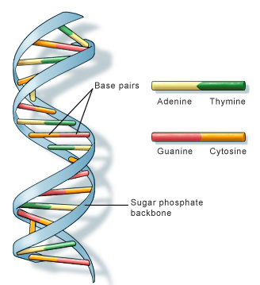

What is DNA?
DNA Structure

Slide 12
What is DNA?
In the case of human beings, there are about 3 million bases, 99.7% of which are the same from person to person.
The variations found in the final 0.3% are the means by which DNA becomes unique to each individual.
The final 0.3% also serves as the foundation for DNA biometrics, being the location of the unique traits by which DNA recognition can identify or verify the identification of an individual person.

Slide 13
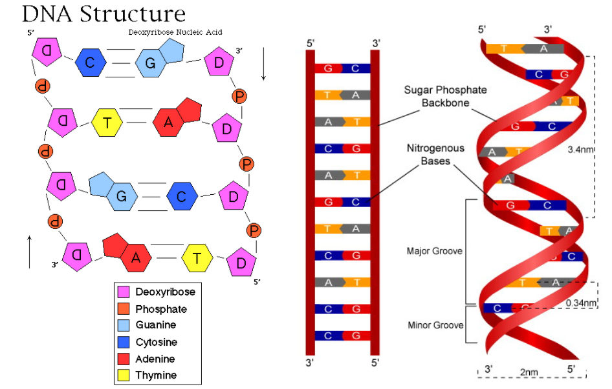
What is DNA?

Slide 14
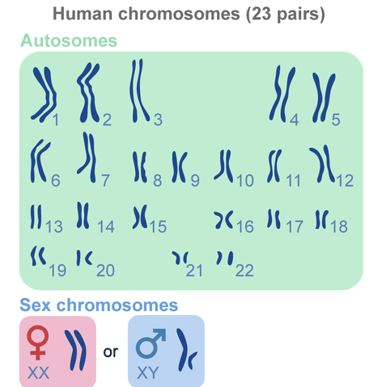
How DNA recognition works?
The cells that contain DNA share genetic material (information) through chromosomes.
Humans have 23 chromosomes that house a person’s DNA and their genes.
In humans, each cell normally contains 23 pairs of chromosomes, for a total of 46.

Slide 15
How DNA recognition works?
Of the 46 total chromosomes, 23 come from each parent of an offspring.
99.7% of an offspring’s DNA is shared with their parents.
The remaining 0.3% of an individuals DNA is variable repetitive coding unique to an individual.
This repetitive coding is the basis of DNA biometrics.
The repetitive coding is called short tandem repeat (STR) (also referred to as “microsatellites”) .
DNA recognition uses genetic profiling, also called genetic fingerprinting, to isolate and identify these repetitive DNA regions that are unique to each individual to either identify or verify a person’s identity.

Slide 16
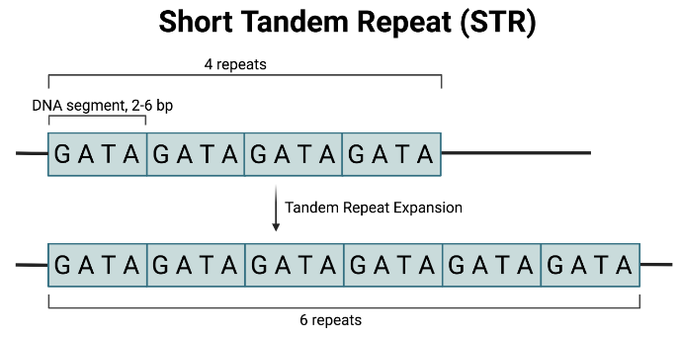
How DNA recognition works?
The basic steps of DNA profiling include:
    Isolate the DNA (sample can originate from blood, saliva, hair, semen, or tissue)
    Section the DNA sample into shorter segments containing known variable number tandem repeats (VNTRs)—identical repeat sequences of DNA
    Organize the DNA segments by size
    Compare the DNA segments from various samples
Tandem repeats can be found on many chromosomes, and often show variations in length among individuals.
A representation of the variable number tandem repeat (VNTR) patterns (alleles)

Slide 17
How DNA recognition works?
The more repeats of sequences there are for a given sample, the more accurate the DNA comparison will be, thus decreasing the likelihood of the sample matching multiple individuals.
In other words, the more detailed the sample is, the more precise the comparison is in identifying the individual who possesses the DNA from the sample.
A few drawbacks of this technique are the depth of the procedure, the physical invasiveness of obtaining the DNA sample, and the time required to perform a DNA comparison.
Also contamination of the sample renders the comparison impossible.

Slide 18
How DNA recognition works?
Most often, DNA biometrics is used for identification purposes as opposed to verification because the technique has yet to automate through technological advances.
DNA sequencing, the process of generating a DNA profile, is compared to DNA samples previously acquired and catalogued in a database.
The most common DNA database in existence is the CODIS System used by the Federal Bureau of Investigation (FBI).
DNA biometrics technology is not advanced enough for universal use.
Current DNA biometrics is far from that depicted in the movies.

Slide 19
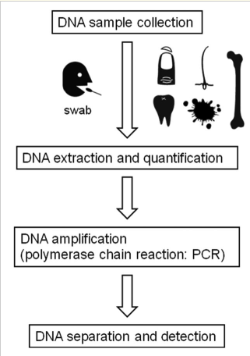


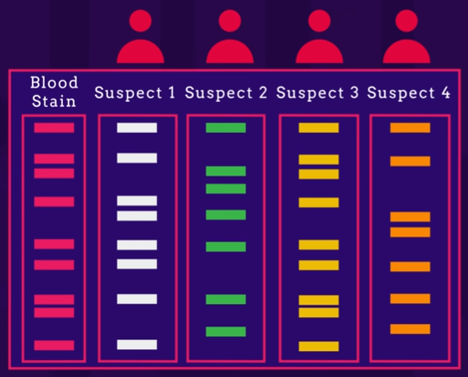
How DNA recognition works?
Analysing 0.3%

Slide 20
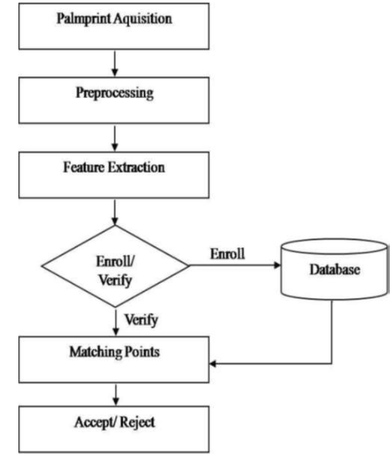
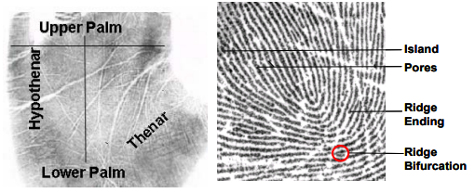
Palm Print Recognition
Minutiae-based matching, the most widely used technique, relies on the minutiae points, specifically the location, direction, and orientation of each point.

Slide 21
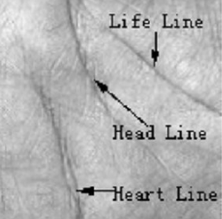
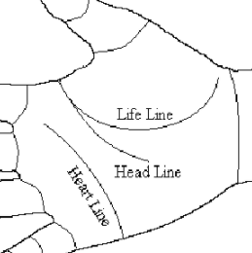
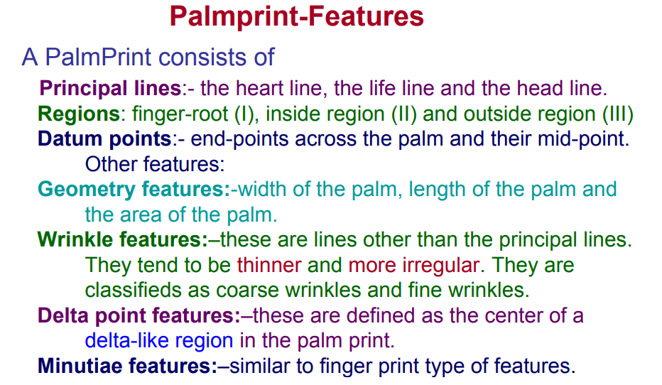
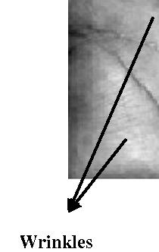
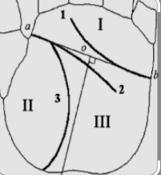

Palm Print Recognition
Principal lines
Regions

Slide 22
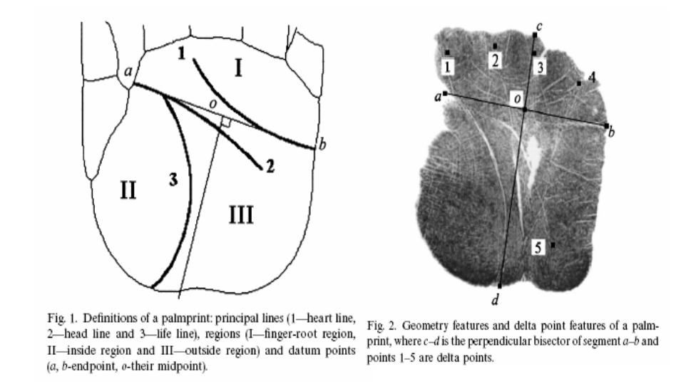
Palm Print Recognition

Slide 23
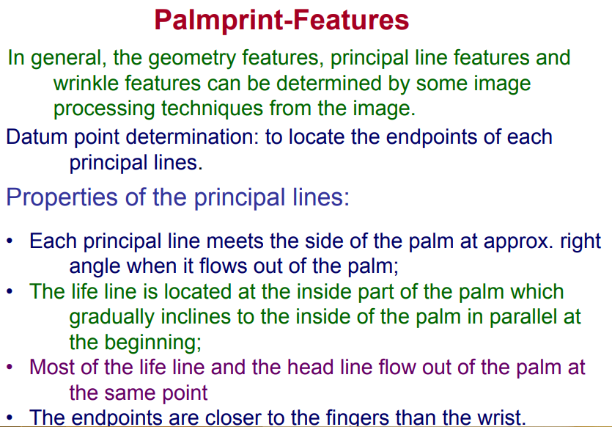
Palm Print Recognition

Slide 24
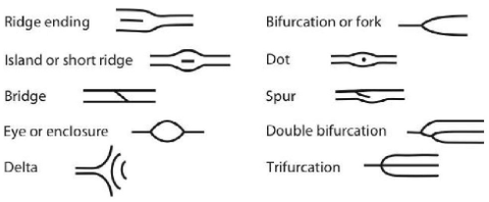
Palm Print Recognition
Palm print recognition inherently implements many of the same matching characteristics that have allowed fingerprint recognition to be one of the most well-known and best publicized biometrics.
Both palm and finger biometrics are represented by the information presented in a friction ridge impression.
This information combines ridge flow, ridge characteristics, and ridge structure of the raised portion of the epidermis.

Slide 25
Palm Print Recognition
The data represented by these friction ridge impressions allows a determination that corresponding areas of friction ridge impressions either originated from the same source or could not have been made by the same source.
Because fingerprints and palms have both uniqueness and permanence, they have been used for over a century as a trusted form of identification.
However, palm recognition has been slower in becoming automated due to some restraints in computing capabilities and live-scan technologies.

Slide 26
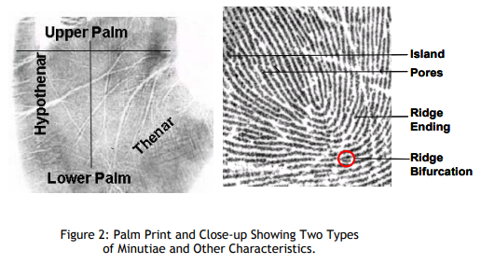
Palm Print Recognition
The images in Figure 2 present a pictorial representation of the regions of the palm, two types of minutiae, and examples of other detailed characteristics used during the automatic classification and minutiae extraction processes.

Slide 27
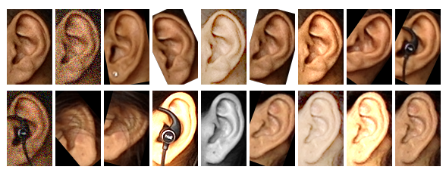
Ear Biometrics
Like other biometric using face, iris, finger, etc, the ear as a biometric contains a large amount of specific and unique features that allow for human identification. Is this the person who he or she claims to be?
The ear morphology changes slightly after the age of 10 years and medical studies have shown that significant changes in the shape of the ear happen only before the age of 8 years and after the age of 70 years.

Slide 28
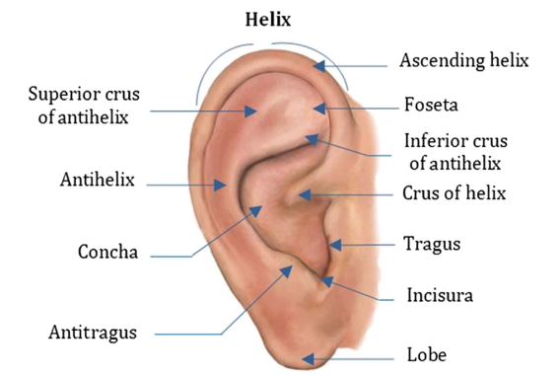
Ear Biometrics
It does grow symmetrically in size and begins to bulge downwards as the person ages, but that is a measurable effect. Studies suggest that ear changes only 1.22 mm per year (Re-enrollment??).
Also, the color distribution of ear, unlike face, is almost uniform. The position of the ear is almost in the middle of the profile face.
Ear data can be captured even without the awareness of the subject from a distance.
11 anatomical ear components

Slide 29
Ear Biometrics
Ear biometrics can stand as an excellent example for passive biometrics and does not need much cooperation from the subject, which meets the demand of the secrecy of the authentication system present in the environment.
But, the researches still discuss if the ears are unique or unique enough to be used as biometrics (no clear evidence).
Thus, Ear shape applications are not commonly used, yet, but the area is interesting especially in crime investigation.

Slide 30
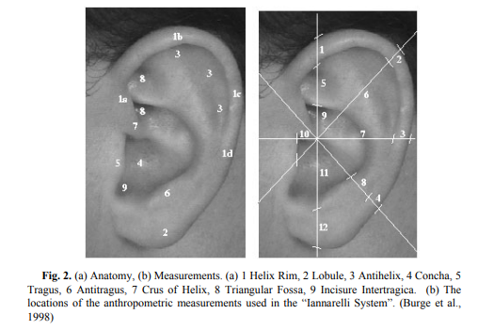
Ear Biometrics – How it works?
A digital camera takes the profile face images of the subjects in the environment from different angles, from which the section of the ear is segmented, preprocessed.
Earmarks
(1,2,3,4…)
Ear identification can
be done from photographs
or from video.

Slide 31
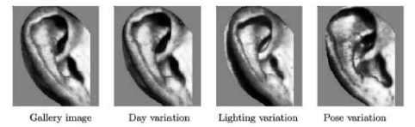
Ear Biometrics – How it works?
The feature vectors are then analyzed in different test cases which consist of the rotation of the face in the same plane, different plane, different light conditions, etc.
Features are given to the AI model as input which would be trained to recognize a person in the environment.

Slide 32
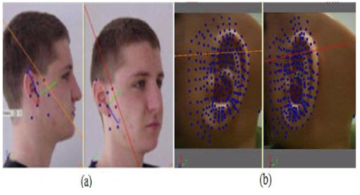
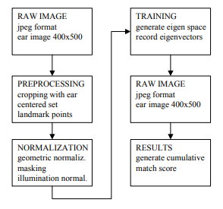
Ear Biometrics – How it works?
The working of Ear biometrics

Slide 33
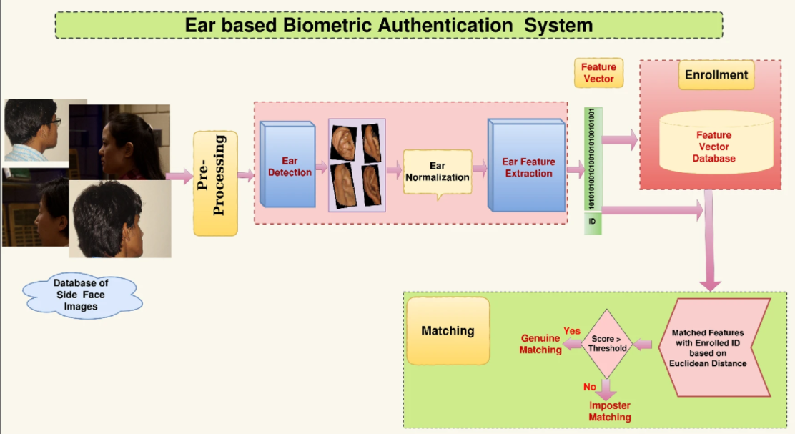
Ear Biometrics – How it works?
Researches have found that even identical twins have different ear shapes.

Slide 34
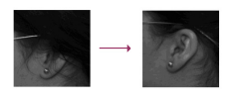
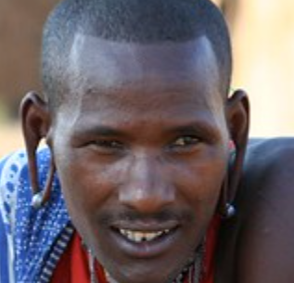
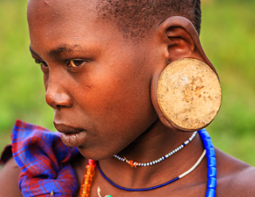
Ear Biometrics – How it works?
An ideal biometric is universal, unique, permanent and collectable.
This means that each person should possess the characteristics (universal) and no two persons should share the characteristics (unique).
The characteristics should not change (permanent) and they should be easily presentable to a sensor and quantifiable (collectable).
Challenges

Slide 35
Hand Geometry - Hand Shape
Hand geometry is based on the palm and fingers structure, including width of the fingers in different places, length of the fingers, thickness of the palm area, etc.
Although these measurements are not very distinctive among people, hand geometry can be very useful for identity verification, i.e. personal authentication.
Special task is to combine some non-descriptive characteristics in order to achieve better identification results.

Slide 36
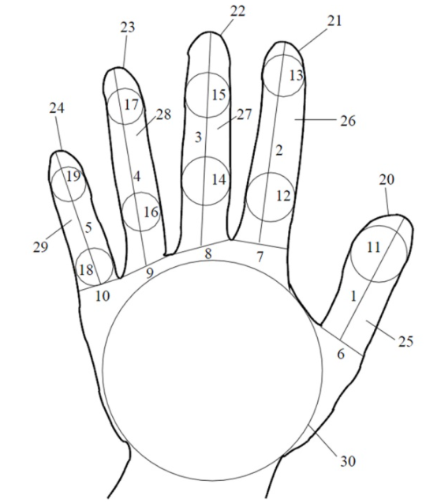
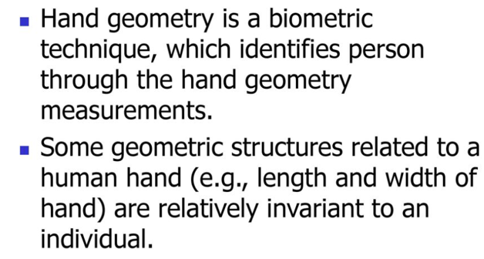
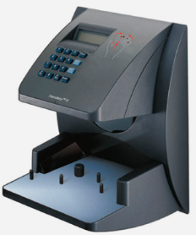
Hand Geometry - Hand Shape
Length, width, thickness and surface area of the hand

Slide 37
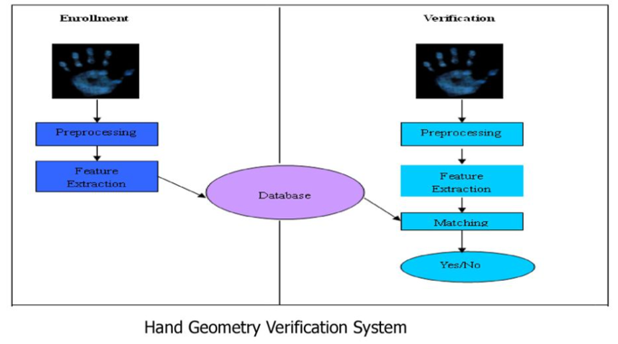
Hand Geometry – Hand shape

Slide 38
Keystroke Recognition
What are keystroke dynamics?
How can it improve your authentication?
Why should you consider it for your multifactor authentication?
What are keystroke recognition?
This method is considered to be a “behavioral biometric”

Slide 39
KEYSTROKE DYNAMICS
Keystroke dynamics or typing biometrics refers to the automated method of identifying or confirming the identity of an individual based on the manner and the rhythm of typing on a keyboard.
Keystroke dynamics is a behavioral biometric, this means that the biometric factor is ‘something you do’.

Slide 40
Keystroke Recognition
Keystroke recognition is a behavioral biometric which utilizes the unique manner in which a person types to verify the identity of an individual.
Typing patterns are predominantly extracted from computer keyboards, but the information can potentially be gathered from any input device having traditional keys with tactile response (i.e., cellular phones, PDA’s, etc).

Slide 41
HOW IT WORKS
The biometric template used to identify an individual is based on the typing pattern, the rhythm and the speed of typing on a keyboard.
The raw measurements used for keystroke dynamics are dwell time and flight time.
Dwell time is the time duration that a key is pressed - Key-Down
Flight time is the time duration in between releasing a key and pressing the next key - Key-Up.

Slide 42
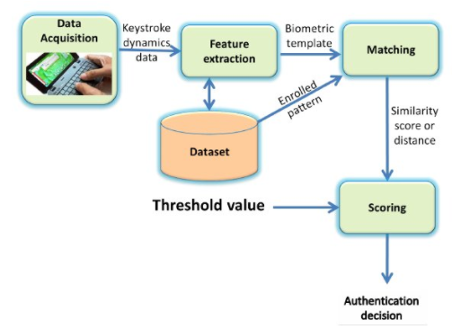
HOW IT WORKS
Various unique features are then calculated based on the intra-key and inter-key timing variations between these events.
Database
In general, keystroke dynamics are less reliable due lack of – Universality Uniqueness, Permanence, Collectability, Acceptability, Performance

Slide 43
APPLICATION OF KEYSTROKE Recognition
two-factor authentication - Keystroke dynamics can be used for authentication, then it is used mostly together with user ID / password credentials.
Another use is as a very specific form of surveillance. There exist software solutions which, often without end-users being aware of it, track keystroke dynamics for each user account. This tracking, historization of keystroke dynamics is then used to analyse whether accounts are being shared or in general are used by people different from the genuine account owner. Reasons for such an implementation could be verification of users following security procedures (password sharing) or to verify that no software licenses are being shared (especially for SAAS applications).

Slide 44
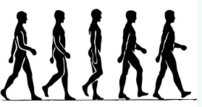
GAIT RECOGNITION
Gait is an important indicator that is used in behavioral biometrics to identify a person over a long distance without direct contact.
When a person walks, it is possible to observe around 24 individual parameters and movements that form the uniqueness of the gait.
Characteristics of the way we walk
Video Cameras or Wearable Sensor (WS) based methods can be used to capture the data for gait.

Slide 45
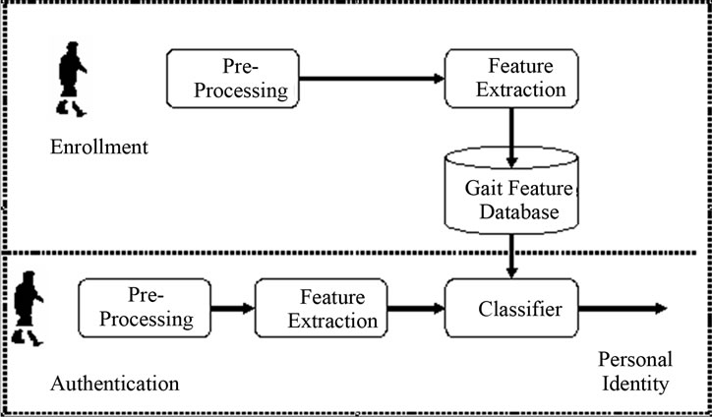
HOW DOES GAIT RECOGNITION WORK?
Angles and joints movement (bone structure).
You don’t need to see the face.

Slide 46
HOW GAIT RECOGNITION IS USED
Gait recognition systems are mainly used in video surveillance and come in handy in crowded areas for security purposes.
The systems can quickly spot a person who is wanted by the authorities and prevent terrorist attacks or other forms of crime.
Gait biometrics can recognize a person it already knows with almost 97 percent accuracy.
It has been applied in Australia to solve a murder.
The system also copes successfully with cheating — when someone tries to imitate a gait.

Slide 47
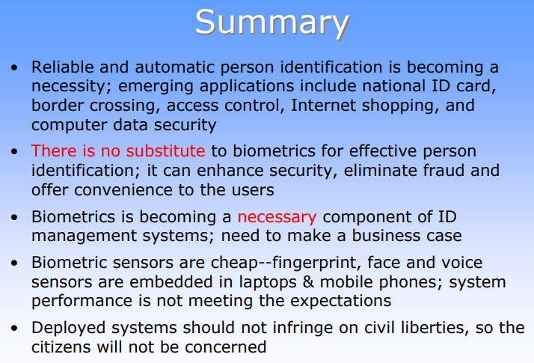

Slide 48


