Slide 1
PYTHON LECTURE Six, Seven, Eight, Nine, Ten, Eleven, Twelve
SALIM AMOUR DIWANI
salim.diwani@udom.ac.tz

Slide 2
Conditional Statements
Questions and answers
A programmer writes a program and the program
asks questions. A computer executes the
program and provides the answers. The program
must be able to react according to the received
answers. Fortunately, computers know only two
kinds of answers:
yes, this is true;
no, this is false.

Slide 3
Conditional Statements
If Statement
I wake up
If I am hungry
I eat breakfast
if condition:
conditional code
If 5 == 15/3:
print(“Horray!”)
Horay is printed
If 5 == 18/3:
Print (“Horray”)
Here nothing is printed
If Else Statement
I leave my house
If it is cloudy
I bring an umbrella
Otherwise
I bring sunglasses
if condition:
conditional code
else:
else code
If x > 3 = computer: case 1
If x <= 3 = computer: case 2
X = 1
If x > 3:
print(“case 1”)
else:
Print (“case 2”)

Slide 4
Conditional Statements
I am at a Restaurant
If I want meat
I order a steak
Otherwise if I want pasta
I order spaghetti and meatballs
Otherwise
I order a salad

Slide 5
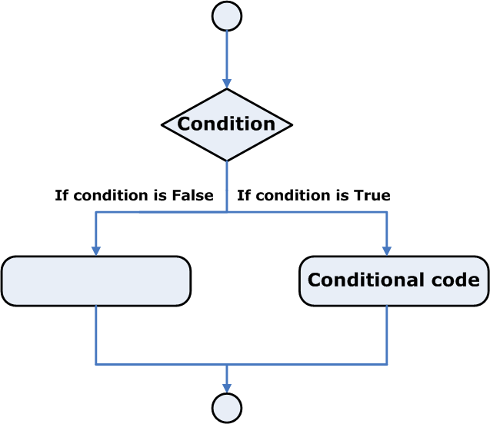
Conditional Statements

Slide 6
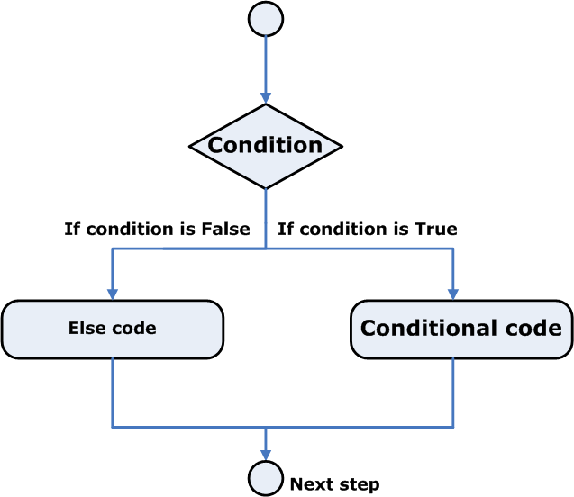
Conditional Statements

Slide 7
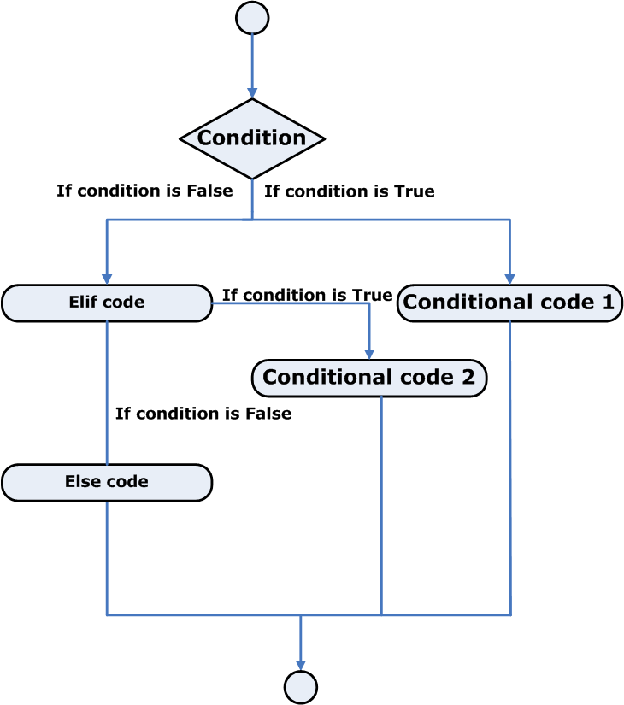
Conditional Statements

Slide 8
Equality: the equal to operator (==)
The "equal to" operator is a comparison operator
in many programming languages. It is used to
compare two values and determine whether they
are equal to each other. The symbol used for
"equal to" varies by programming language, but
it is commonly represented as "==". For example,
in Python, you can use the "equal to" operator
like this:

Slide 9
Equality: the equal to operator (==)
if a == b: print("a is equal to b")
The == (equal to) operator compares the values
of two operands. If they are equal, the result of
the comparison is True. If they are not equal, the
result of the comparison is False.

Slide 10
Equality: not equal to operator (!=)
The "not equal to" operator is a comparison
operator in many programming languages. It is
used to compare two values and determine
whether they are not equal to each other. The
symbol used for "not equal to" varies by
programming language, but it is commonly
represented as "!=". For example, in Python, you
can use the "not equal to" operator like this:

Slide 11
Equality: not equal to operator (!=)
if a != b: print("a is not equal to b")
The != (not equal to) operator compares the
Values of two operands, too. Here is the
difference: if They are equal, the result of the
comparison is False. If they are not equal, the
result of the comparison is True.

Slide 12
Comparison Operators: greater than
The "greater than" operator is a comparison
operator in many programming languages. It is
used to compare two values and determine
whether the first value is greater than the second
value. The symbol used for "greater than" varies
by programming language, but it is commonly
represented as ">". For example, in Python, you
can use the "greater than" operator like this:

Slide 13
Comparison Operators: greater than
if a > b: print("a is greater than b")
This code would check if the value of a is greater
than the value of b, and if it's true, it would print
the message "a is greater than b".

Slide 14
Comparison Operators: greater than or equal to
The comparison operator "greater than or equal to
" (≥) is used to compare two values and
determine if the first value is greater than or
equal to the second value. This operator is often
used in programming languages, mathematical
expressions, and other forms of logic and
comparison.

Slide 15
Comparison Operators: greater than or equal to
In a programming context, for example, it can be
used in an if statement to check if a variable is
greater than or equal to a certain value and
perform actions accordingly. The syntax for
"greater than or equal to" comparison operator
may vary between programming languages, but
the meaning remains the same.

Slide 16
Comparison Operators: less than or equal to
The comparison operator "less than or equal to"
(≤) is used to compare two values and determine
if the first value is less than or equal to the second
value. This operator is often used in programming
languages, mathematical expressions, and other
forms of logic and comparison.

Slide 17
Comparison Operators: less than or equal to
In a programming context, for example, it can be
used in an if statement to check if a variable is
less than or equal to a certain value and
perform actions accordingly. The syntax for
"less than or equal to" comparison operator may
vary between programming languages, but the
meaning remains the same.

Slide 18
More Example
is_male = True
if is_male:
print(“You are a male”)
else:
print(“You are not a male”)
is_male = True
if is_male:
print(“You are a male”)
is_male = False
if is_male:
print(“You are a male”)

Slide 19
More Example
is_male = True
is_tall = True
If is_male or is_tall:
print(“You are a male or tall or both”)
else:
print(“You neither male nor tall”)

Slide 20
More Example
is_male = True
is_tall = True
If is_male and is_tall:
print(“You are a tall male”)
else:
print(“You are either not male or not tall or both”)

Slide 21
More Example
is_male = True
is_tall = True
If is_male and is_tall:
print(“You are a tall male”)
elif: is_male and not (is_tall):
print(“You are a short male”)
elif: not (is_male) and is_tall:
print(“You are not a male but are tall”)
else:
print(“You are either not male or not tall or both”)

Slide 22
Lab
Using one of the comparison operators in Python,
write a simple two-line program that takes the
parameter n as input, which is an integer, and
prints False if n is less than 100, and True if n is
greater than or equal to 100.
Test Data
Sample input
55, 99, 100, 101, -5, +123

Slide 23
Loops in Python
Looping your code with while
Do you agree with the statement presented below?
while there is something to do
do it
Note that this record also declares that if there is
nothing to do, nothing at all will happen.

Slide 24
"while" loop
The "while" loop in Python is a control flow structure that repeatedly executes a block of code as long as a given
condition is true.
The "else" branch in a while loop is optional, and it is
executed if and only if the condition in the while loop
evaluates to False. This means that the else branch is
executed after the loop has finished executing, but only
if the loop was not terminated by a "break" statement.
Here's an example to demonstrate the use of a while
loop with an else branch:

Slide 25
"while" loop
In general, in Python, a loop can be represented as follows:
while conditional_expression:
instruction
Or
while conditional_expression:
instruction_one
instruction_two
instruction_three : :
instruction_n

Slide 26
"while" loop
i = 0
while i < 5:
print(i) i += 1
else:
print("The loop has finished executing")
Output: 0 1 2 3 4 The loop has finished executing

Slide 27
For Loop
The for loop and the range() function are used in Python to repeat a certain block of code a specified number of
times. The range() function generates a sequence of
numbers, which is then used as the loop variable in the
for loop. Here's a basic example:
for i in range(5):
print(i)
This code will print the numbers 0, 1, 2, 3, and 4. The range() function takes in one, two, or three arguments:

Slide 28
For Loop
range(stop)
range(start, stop)
range(start, stop, step)
The stop argument specifies the upper bound of the
range and is required. The start argument is the starting value of the range, and step is the difference between
each consecutive number in the sequence. If start is not specified, it defaults to 0. If step is not specified, it
defaults to 1.

Slide 29
"break" and "continue"
"break" and "continue" are control flow statements
used in programming languages. "break" is used to exit a loop prematurely. When a "break" statement is
encountered within a loop, the loop is terminated
immediately and the program continues with the next
statement after the loop.

Slide 30
"break" and "continue"
"continue" is used to skip the current iteration of a loop
and move on to the next one. When a "continue"
statement is encountered within a loop, the program
skips the current iteration and continues with the next
iteration of the loop.
for i in range(10):
if i == 5:
break
print(i)
Output: 0 1 2 3 4

Slide 31
"break" and "continue"
for i in range(10):
if i == 5:
continue
print(i)
Output: 0 1 2 3 4 6 7 8 9

Slide 32
Quiz
Create a for loop that counts from 0 to 10, and prints
odd numbers to the screen. Use the skeleton below:
for i in range(1, 11):
# Line of code.
# Line of code.

Slide 33
Quiz
2. Create a while loop that counts from 0 to 10, and prints odd numbers to the screen. Use the skeleton below:
x = 1
while x < 11:
# Line of code.
# Line of code.
# Line of code.

Slide 34
Quiz
3. Create a program with a for loop and a break
statement. The program should iterate over characters
in an email address, exit the loop when it reaches
the @ symbol, and print the part before @ on one line.
Use the skeleton below:
for ch in "john.smith@pythoninstitute.org":
if ch == "@":
# Line of code.
# Line of code.

Slide 35
Quiz
4. Create a program with a for loop and a continue statement. The program should iterate over a string of digits, replace each 0 with x, and print the modified string to the screen. Use the skeleton below:
for digit in "0165031806510":
if digit == "0":
# Line of code.
# Line of code.
# Line of code.

Slide 36
Quiz
5. What is the output of the following code?
n = 3
while n > 0:
print(n + 1)
n -= 1
else:
print(n)

Slide 37
Quiz
6. What is the output of the following code?
n = range(4)
for num in n:
print(num - 1)
else:
print(num)

Slide 38
Quiz
7. What is the output of the following code?
for i in range(0, 6, 3):
print(i)

Slide 39
Computer logic
Computer logic refers to the systematic methods and
principles used by computers to process, store, and
retrieve information, make decisions, and
perform tasks. It encompasses the principles of mathematical logic, circuit design, and computer science that
form the basis of how computers operate.

Slide 40
Computer logic
In computer logic, logical operations such as AND, OR, NOT, NAND, and NOR are used to manipulate binary
data (i.e., data represented as 1s and 0s). These
operations allow computers to make decisions, store
and retrieve information, and perform tasks.

Slide 41
Computer logic
If we have some free time, and the weather is good, we will go for a walk.
We've used the conjunction and, which means that
going for a walk depends on the simultaneous fulfilment of these two conditions. In the language of logic, such a connection of conditions is called a conjunction.

Slide 42
Computer logic
If you are in the mall or I am in the mall, one of us will buy a gift for Mom.
The appearance of the word or means that the purchase
depends on at least one of these conditions. In logic, such a compound is called a disjunction.
It's clear that Python must have operators to build
conjunctions and disjunctions. Without them, the
expressive power of the language would be substantially
weakened.They're called logical operators.

Slide 43
logical conjunction operator
and
One logical conjunction operator in Python is the word
and. It's a binary operator with a priority that is lower than the one expressed by the comparison
operators. It allows us to code complex conditions
without the use of parentheses like this one:
counter > 0 and value == 100
The result provided by the and operator can be
determined on the basis of the truth table.

Slide 44
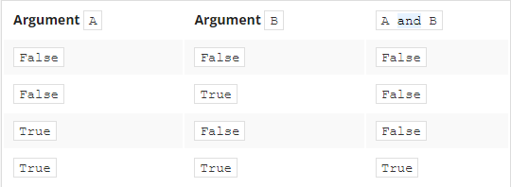
logical conjunction operator
If we consider the conjunction of A and B, the set of
possible values of arguments and corresponding values of the conjunction looks as follows:

Slide 45
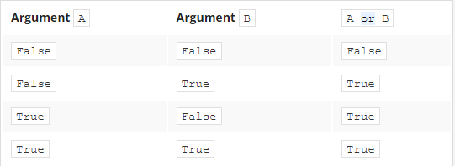
logical conjunction operator
or
A disjunction operator is the word or. It's a binary
operator with a lower priority than and (just like + compared to *). Its truth table is as follows:

Slide 46
logical conjunction operator
not
In addition, there's another operator that can be applied
for constructing conditions. It's a unary operator
performing a logical negation. Its operation is simple:
it turns truth into falsehood and falsehood into truth.
This operator is written as the word not, and its priority
is very high: the same as the unary + and -. Its truth
table is simple:

Slide 47
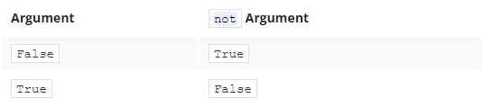
logical conjunction operator

Slide 48
Logical expression
A logical expression is a statement that can be either true
or false. In computer programming, logical expressions
are used to make decisions, control the flow of execution,
and perform operations based on conditions.
Logical expressions can be constructed using logical
operators such as AND, OR, NOT, XOR, NAND, and
NOR. These operators work on binary values
(i.e., True or False) and return a result that is also a
binary value.

Slide 49
Logical expression
Here are some examples of logical expressions in Python:
a = True
b = False
# using AND operator
print(a and b) # False
# using OR operator
print(a or b) # True
# using NOT operator
print(not a) # False

Slide 50
Logical expression
Logical expressions are widely used in computer
programming to make decisions and control the flow
of execution in programs. For example, in an if
statement, a logical expression is used to determine
whether a blockof code should be executed or not.

Slide 51
Bitwise operators
Bitwise operators in computer programming are
operations that manipulate individual bits in a binary
number. These operators are commonly used to perform
low-level operations such as testing the value of
individual bits, setting or clearing bits, or shifting
bits left or right.

Slide 52
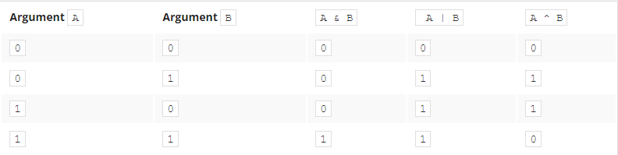
Bitwise operators
& (ampersand) - bitwise conjunction;
| (bar) - bitwise disjunction;
~ (tilde) - bitwise negation;
^ (caret) - bitwise exclusive or (xor).
Bitwise operations (&, |, and ^)

Slide 53
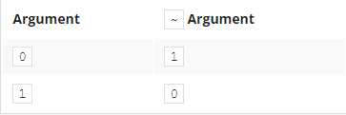
Bitwise operators
Bitwise operations (~) negation
Let's make it easier:
& requires exactly two 1s to provide 1 as the result;
| requires at least one 1 to provide 1 as the result;
^ requires exactly one 1 to provide 1 as the result.

Slide 54
Bitwise operators
Note that bitwise operations are faster than arithmetic
operations and are often used in computer systems and
embedded devices where performance is critical.
However, they can also be more difficult to understand
and debug, so they should be used with care.

Slide 55
Binary left shift and binary right shift
Python offers yet another operation relating to single bits:
shifting. This is applied only to integer values, and you
mustn't use floats as arguments for it.
You already apply this operation very often and quite
unconsciously. How do you multiply any number by ten?
Take a look:
12345 × 10 = 123450
As you can see, multiplying by ten is in fact a shift of
all the digits to the left and filling the resulting gap with
zero.

Slide 56
Binary left shift and binary right shift
Division by ten? Take a look:
12340 ÷ 10 = 1234
Dividing by ten is nothing but shifting the digits to the right.
The same kind of operation is performed by the computer,
but with one difference: as two is the base for binary
numbers (not 10), shifting a value one bit to the left
thus corresponds to multiplying it by two; respectively,
shifting one bit to the right is like dividing by two
(notice that the rightmost bit is lost).

Slide 57
Binary left shift and binary right shift
The shift operators in Python are a pair of digraphs:
<< and >>, clearly suggesting in which direction the shift
will act.
value << bits
value >> bits
The left argument of these operators is an integer
value whose bits are shifted. The right argument
determines the size of the shift.

Slide 58
Binary left shift and binary right shift
var = 17
var_right = var >> 1
var_left = var << 2
print(var, var_left, var_right)
The final print() invocation produces the following output:
17 68 8
Note:
17 >> 1 → 17 // 2 (17 floor-divided by 2 to the power of1) → 8 (shifting to the
right by one bit is the same as integer division by two)
17 << 2 → 17 * 4 (17 multiplied by 2 to the power of 2) → 68 (shifting to the left
by two bits is the same as integer multiplication
by four)

Slide 59
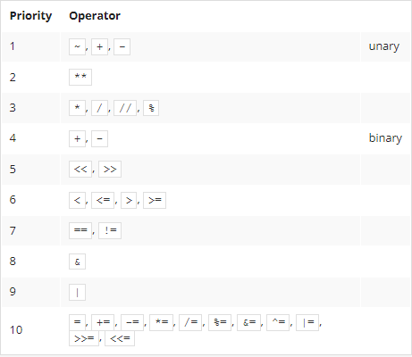
Updated Priority Table

Slide 60
Quiz
1. What is the output of the following snippet?
x = 1
y = 0
z = ((x == y) and (x == y)) or not(x == y)
print(not(z))

Slide 61
Quiz
2. What is the output of the following snippet?
x = 4
y = 1
a = x & y
b = x | y
c = ~x # tricky!
d = x ^ 5
e = x >> 2
f = x << 2
print(a, b, c, d, e, f)

Slide 62
Function
A function in Python is a block of code that can be
executed whenever it is called. Functions help break
down large, complex code into smaller, more
Manageable pieces, making it easier to understand
and maintain. Functions also allow for reusability of code.
In Python, you can define a function using the def
keyword, followed by the function name, any arguments it
may take in parentheses, and a colon. The code inside
the function must be indented. The function can return a
value using the return keyword.

Slide 63
Defining a Function
def function_name (parameters):
function body
def simple():
print (“My First Function”)
We must call a function by typing simple()

Slide 64
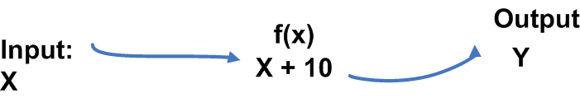
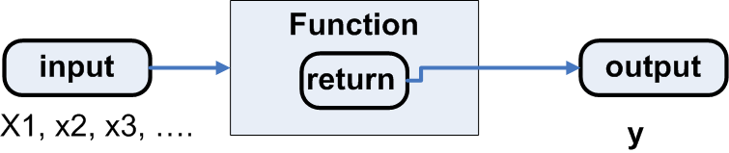
Creating a Function with a Parameter
def plus_ten(a):
return a + 10
plus_ten (2)
plus_ten (5)

Slide 65
Using a Function within a Function
def wage(w_hours):
return w_hours * 25
def with_bonus(w_hours):
return wage(w_hours) + 50
Call a function: wage(8), with_bonus(8)

Slide 66
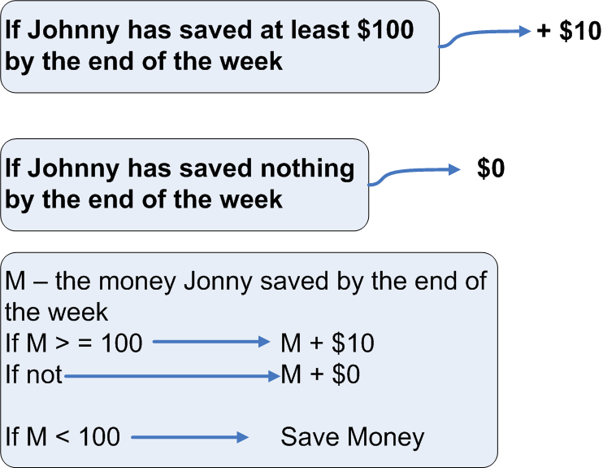
Combining Conditional Statements and Functions

Slide 67
Combining Conditional Statements and Functions
def add_10():
if m >= 100:
m = m + 10
return m
else:
return “save more!”

Slide 68
Built-in Functions
A built-in function is a function that is included in the
standard library of a programming language and is
available for use without requiring any additional modules
or libraries to be installed. Built-in functions are
pre-defined and can be used directly in your code to
perform a specific task, such as converting data types,
performing mathematical operations, or manipulating
strings.

Slide 69
Built-in Functions
In Python, for example, some common built-in functions
include print(), len(), max(), min(), abs(), sum(), int(),
float(), str(), and input(). These functions can be called
directly in your code to perform various tasks, such as
printing to the console, determining the length of a string,
finding the maximum value in a list, or converting data
types.

Slide 70
List
A list is a data structure that holds an ordered
Collection of items, which can be of different types. Or a
list is a type of sequence of data points. Lists are
Defined by square brackets [ ] and the items are
separated by commas and use quotation marks for
string.
Example:
fruits = ['apple', 'banana', 'cherry']
numbers = [1, 2, 3, 4, 5]

Slide 71
List
“Name_of_list”[index_of_element]
Don’t use () or {}!
Participants = [“Salim”, “Amour”, “Diwani”, “Imu”]
Print (participants[1])
Accessing the list by indexing the value 1 = extract the
second of the elements in this list variable.
del (participants [2])

Slide 72
List
fruits = ["apple", "banana", "cherry"]
numbers = [1, 2, 3, 4, 5]
mixed = [1, "dog", 3.14, True]
# Add an element to the end of the list using append()
fruits.append ("orange")
# Insert an element at a specific index using insert()
fruits.insert(1, "grapes")

Slide 73
List
# Remove an element using remove()
fruits.remove("banana")
# Access an element by its index
print(fruits[0]) # "apple"
# Modify an element by its index
fruits[1] = "pear"

Slide 74
List
# Check the length of the list using len()
print(len(fruits)) # 3
# Sort the list using sort()
numbers.sort()

Slide 75
Slicing
Slicing in Python refers to the extraction of a portion of a
sequence, such as a string, list, tuple, etc. The slicing
operation is performed by providing two indices separated
by a colon : in square brackets []. The first index
represents the starting position of the slice, and the
second index represents the end position. The slice will
include all elements between the start and end positions,
including the element at the start position and excluding
the element at the end position. The following is an
example of slicing a list in Python:

Slide 76
Slicing
>>> my_list = [0, 1, 2, 3, 4, 5]
>>> my_list[1:4]
[1, 2, 3]
In this example, the slice my_list[1:4] returns the elements at
indices 1, 2, and 3 of my_list, which are 1, 2, 3.

Slide 77
Slicing
Participants = [‘John’, ‘Leila’, ‘Maria’ ‘Dwaine’, ‘George’, ‘Catherine’]
Participants [1:3]
Output: [‘Leila’, ‘Maria’ ]
Participants [:2]
Output: [‘John’, ‘Leila’]
Participants [4:]
Output: [‘George’, ‘Catherine’]
Participants [-2:]
Output: [‘George’, ‘Catherine’]

Slide 78
Slicing
Participants = [‘John’, ‘Leila’, ‘Maria’ ‘Dwaine’, ‘George’, ‘Catherine’]
Participants.index(Maria)
Output: 2
.sort() sorts objects of list
Participants.sort()
Participants.sort(reverse=True)
Numbers = [1,2,3,4,5]
Numbers.sort()
Numbers
Output: [1,2,3,4,5]

Slide 79
Slicing
Numbers = [1,2,3,4,5]
Numbers.sort(reverse=True)
Numbers
Output: [5,4,3,2,1]

Slide 80
Thanks for Your Attention

