Slide 1
CP 311: Internet Programming And Applications II
LECT_TWO

Slide 2

Introduction
XML stand for: eXtensible Markup Language
Developed from SGML (standard generalized markup language)
XML was designed to transport and store data.
XML is a meta-language.
A meta-language is a language that's used to define other languages.
You can use XML for instance to define a language like WML.
Deficiencies of HTML and SGML

Slide 3
Introduction
Lax syntactical rules
Many complex features that are rarely used
XML can be written by hand or generated by computer
Useful for data exchange
XML documents are processed by passers, a program that analyzes the syntax or structure of a given file.

Slide 4
Introduction
XML tags are not predefined.
You must define your own tags
XML is designed to be self-descriptive
XML is a W3C Recommendation
XML is Not a Replacement for HTML

Slide 5
Introduction
What you can do with XML:
            Define data structures
            Make these structures platform independent
            Process XML defined data automatically
            Define your own tags
    What you cannot do with XML:
            Define how your data is shown.
            To show data, you need other techniques.

Slide 6
Differences between XML & HTML
XML and HTML were designed with different goals:
XML was designed to transport and store data, with focus on what data is.
HTML was designed to display data, with focus on how data looks.
HTML is a markup language used to describe the layout of any kind of information
XML is a meta-markup language that can be used to define markup languages that can define the meaning of specific kinds of information
XML does not predefine any tags whereas HTML tags are predefined in the official specification of HTML
In XML, all opening tags must have a matching closing tag.

Slide 7
Why do we need XML? Data-exchange
XML is used to aid the exchange of data.
It makes it possible to define data in a clear way.
Both the sending and the receiving party will use XML to understand the kind of data that's been sent.
By using XML everybody knows that the same interpretation of the data is used Replacement for EDIEDI (Electronic Data Interchange) has been for several years the way to exchange data between businesses.
EDI is expensive, it uses a dedicated communication infrastructure.
And the definitions used are far from flexible.XML is a good replacement for EDI. It uses the Internet for the data exchange. And it's very flexible.

Slide 8
Why do we need XML? More possibilities
XML makes communication easy. It's a great tool for transactions between businesses.
You can define other languages with XML.
A good example is WML(Wireless Markup Language), the language used in WAP communications.
WML is just an XML dialect.

Slide 9
Rules for writing XML documents
A "Well Formed" XML document has correct XML syntax.
It conforms to the general rules of XML syntax:
XML documents must have a root element
XML elements must have a closing tag
XML tags are case sensitive
XML elements must be properly nested
XML attribute values must be quoted
A Valid XML document is an XML validated against a DTD.
A "Valid" XML document is a "Well Formed" XML document, which also conforms to the rules of a Document Type Definition (DTD)

Slide 10
rules for writing XML documents
Tags that are opened first must close last:
<chapter><intro>Here is an introduction to XML.</intro></chapter
In XML, attributes always use quotation marks around their values:
<intro type="chapter"

Slide 11
Valid XML Document
A valid XML-document has a structure that's valid.
That's the part you can check.
If a document is valid, it's clearly defined what the data in the document really means.
To use XML you need a DTD (Document Type Definition).
A DTD contains the rules for a particular type of XML-documents.
It's the DTD that defines the language.

Slide 12
XML documents use a self-describing and simple syntax.
All elements can have sub elements (child elements):<root> <child> <subchild>.....</subchild> </child> </root>
The terms parent, child, and sibling are used to describe the relationships between elements.
Parent elements have children.
Children on the same level are called siblings (brothers or sisters).
All elements can have text content and attributes (just like in HTML).

Slide 13
XML Naming Rules
XML elements must follow these naming rules:
Names can contain letters, numbers, and other characters
Names cannot start with a number or punctuation character
Names cannot start with the letters xml (or XML, or Xml, etc)
Names cannot contain spaces
Any name can be used, no words are reserved.

Slide 14
Best Naming Practices
Make names descriptive.
Names with an underscore separator are nice: <first_name>, <last_name>.
Names should be short and simple, like this: <book_title> not like this: <the_title_of_the_book>.
Avoid "-" characters.
If you name something "first-name," some software may think you want to subtract name from first.
Avoid "." characters.
If you name something "first.name," some software may think that "name" is a property of the object "first."

Slide 15
Best Naming Practices
Avoid ":" characters.
Colons are reserved to be used for something called namespaces (more later).
XML documents often have a corresponding database.
A good practice is to use the naming rules of your database for the elements in the XML documents.
Non-English letters like éòá are perfectly legal in XML, but watch out for problems if your software vendor doesn't support them.

Slide 16
XML Documents Form a Tree Structure
<!-- This is an XML document -->
<?xml version="1.0" encoding="ISO "?>
<bookstore>
<book category="COOKING">
<title lang="en">Everyday Italian</title>
<author>Giada De Laurentiis</author>
<year>2005</year>
<price>30.00</price>
</book>
</bookstore>
XML Documents Form a Tree Structure.

Slide 17
Parts of XML
Each XML document is divided into two parts: the prolog and the document or root element
The prolog includes an XML declaration and a comment. It can also include other elements, such as processing instructions or a Document Type Definition (DTD).
Well-formed XML documents must have a single document element that may optionally include other content.
Any content within an XML document must appear within the document or root element.

Slide 18
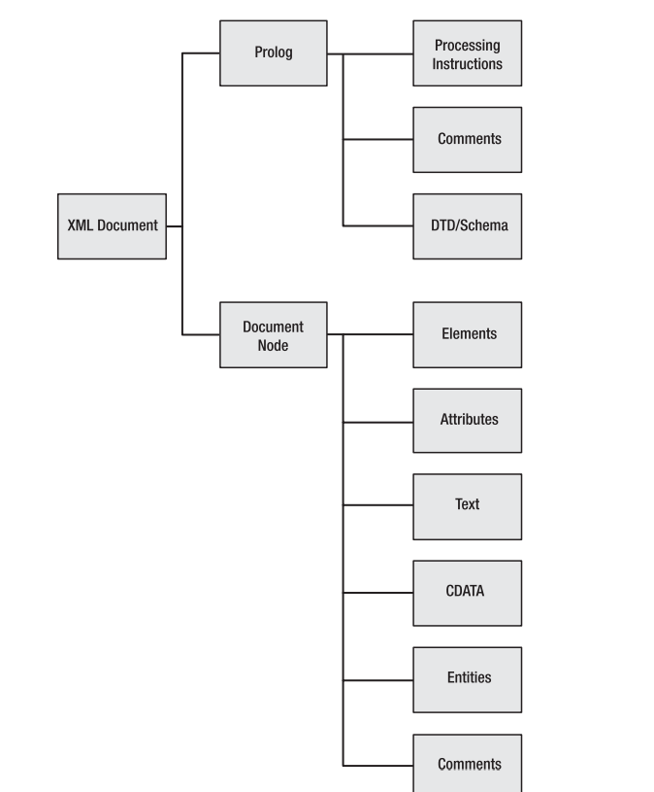

Slide 19
Parts of XML
Declaration:
<?xml version=’1.0’ encoding=’UTF-16’ standalone=’yes’?>
Element: this is any text properly nested between two matching tags: <aTag> ... </aTag>.
Name this refers to the tag’s text e.g."aTag”
Content is the text between the tags.
Parent-child relationships this occurs between elements and are given by the nesting of the tags.

Slide 20
Parts of XML
Attributes can be attached to the opening tag.
Attribute values must be enclosed in quotes.
Empty elements can be given by <aTag/>.
Comments are any text enclosed in <! >processing instructions are enclosed in <? ... ?> and may be used by the XML processor receiving the document.

Slide 21
Attributes in XML Declaration
<?xml version=“1.0” encoding=“UTF-16” standalone=“yes” ?>
Version: This specifies which version of the XML specification the document adheres to.
There are two versions of the XML specification, 1.0 and 1.1

Slide 22
Attributes in XML Declaration
At the time of writing, the current XML version is 1.1. However, many processors don’t recognize this version, so it’s best to stick with a version 1.0 declaration for backward compatibility
Encoding: The encoding declaration identifies which encoding is used to represent the characters in the document. E.g. UTF-8 or UTF-16, ISO Unicode encoding.

Slide 23
Attributes in XML Declaration
Standalone: The standalone declaration indicates whether a document relies on information from an external source, such as external document type definition (DTD), for its content.
It must be set to either yes or no
yes specifies that the document exists entirely on its own, without depending on any other files.
no indicates that the document may depend on an external DTD

Slide 24
Structure of an XML page
<?xml version="1.0"?>
<root>
<element>
<sub-element> content </sub-element>
</element>
</root>

Slide 25
Structure of an XML page(Example 1)
<?xml version="1.0"?>
<sales>
<shop>
<number> 100 </number>
<manager> Ray Bradbury </manager>
</shop>
<product>
<name> carrots </name>
<totalprice> 10 </totalprice>
</product>
</sales>

Slide 26
Structure of an XML page(Example 2)
<?xml version="1.0" encoding="ISO "?>
<patient>
<name>
<first> Maggie </first>
<middle> Dee </middle>
<last> Magpie </last>
</name>
……
……
</patient>

Slide 27
CDATA Section
CDATA stands for Character Data and it means that the data in between these strings includes data that could be interpreted as XML markup, but should not be.
The, this is useful for text that contains reserved XML characters:
<title><!CDATA[ Why 9 is < 10 ]]</title>
You can use CDATA sections in XML documents for embedding code, such as JavaScript, and for adding content that doesn’t need processing
The key differences between CDATA and comments are:
CDATA is still part of the document, while a comment is not.

Slide 28
Displaying on the web
Generally, a generic XML document is rendered as raw XML text by most web browsers.
Some display it with 'handles' (e.g. + and - signs in the margin) that allow parts of the structure to be expanded or collapsed with mouse-clicks.
You need style sheets (CSS or XSLT) to render a display of your choice.
XSLT -eXtensible Stylesheet Language) is a styling language for XML.

Slide 29
Displaying on the web
In order to style the rendering in a browser with CSS or XSLT, the XML document must include a reference to the stylesheets. E.g.
<?xml-stylesheet type="text/css" href="myStyleSheet.css"?>
<?xml-stylesheet type="text/xml" href="myTransform.xslt"?>

Slide 30
XML Document Structure
An XML document uses two Auxiliary files: -
    Schema file
          DTD or XML Schema or one of several other Style file.
    Cascading Style Sheet
          XSLT - XSL (eXtensible Stylesheet Language) is created for this purpose
    An XML document is a tree of elements with a single root
    In XML, you define your own tags.
    If you want to use a tag, you'll have to define it's meaning.
    This definition is stored in a DTD (Document Type Definition).
    You can define your own DTD or use an existing one.
    An alternative for a DTD is Schema.

Slide 31
    Schema file
The XML Document Type Declaration, commonly known as DTD, is a way to describe XML language precisely.
DTDs check vocabulary and validity of the structure of XML documents against grammatical rules of appropriate XML language.
An XML DTD can be either specified inside the document, or it can be kept in a separate document and then liked separately.

Slide 32
Syntax
Basic syntax of a DTD is as follows −
<!DOCTYPE element DTD identifier
[
declaration1
declaration2
........
]>

Slide 33
Syntax
The DTD starts with <!DOCTYPE delimiter.
An element tells the parser to parse the document from the specified root element.
DTD identifier is an identifier for the document type definition, which may be the path to a file on the system or URL to a file on the internet.
If the DTD is pointing to external path, it is called External Subset.
The square brackets [ ] enclose an optional list of entity declarations called Internal Subset.

Slide 34
Internal DTD
A DTD is referred to as an internal DTD if elements are declared within the XML files.
To refer it as internal DTD, standalone attribute in XML declaration must be set to yes.
This means, the declaration works independent of an external source.

Slide 35
Internal DTD (Example)
<?xml version = "1.0" encoding = "UTF-8" standalone = "yes" ?>
<!DOCTYPE address [
<!ELEMENT address (name,company,phone)>
<!ELEMENT name (#PCDATA)>
<!ELEMENT company (#PCDATA)>
<!ELEMENT phone (#PCDATA)>
]>

Slide 36
Internal DTD (Example)
<address>
<name>Tanmay Patil</name>
<company>TutorialsPoint</company>
<phone>(011) 123-4567</phone>
</address>

Slide 37
Internal DTD (Example)
The DOCTYPE declaration has an exclamation mark (!) at the start of the element name.
The DOCTYPE informs the parser that a DTD is associated with this XML document.
DTD Body − The DOCTYPE declaration is followed by body of the DTD, where you declare elements, attributes, entities, and notations.

Slide 38
Internal DTD (Example)
<!ELEMENT address (name,company,phone)>
<!ELEMENT name (#PCDATA)>
<!ELEMENT company (#PCDATA)>
<!ELEMENT phone_no (#PCDATA)>
Several elements are declared here that make up the vocabulary of the <name> document.
<!ELEMENT name (#PCDATA)> defines the element name to be of type "#PCDATA".
Here #PCDATA means parse-able text data.

Slide 39
Internal DTD
Following are some important points that a DTD describes −
  the elements that can appear in an XML document.
  the order in which they can appear.
  optional and mandatory elements.
  element attributes and whether they are optional or mandatory.
  whether attributes can have default values.

Slide 40
XML Document Structure
XML has five predefined entities:
      & (& or "ampersand")
      < (< or "less than")
      > (> or "greater than")
      &apos; (' or "apostrophe")
      " (" or "quotation mark")
Example:
<company_name>AT&T</company_name>

Slide 41
XML Document Structure
The user can only define entities in a DTD if several predefined entities must appear near each other use Character data section<![CDATA[ content ]]>
Example 1
instead of: Start > > > > HERE < < < <
use: <![CDATA[Start >>>> HERE <<<<]]>
Example 2
instead of: <comparison>6 is < 7 & 7 > 6 </comparison>
Use: <comparison><![CDATA[6 is < 7 & 7 > 6]]></comparison>

Slide 42
How Can XML be Used? XML Separates Data from HTML
With XML, data can be stored in separate XML files.
This way you can concentrate on using HTML for layout and display, and be sure that changes in the underlying data will not require any changes to the HTML.
If you need to display dynamic data in your HTML document, it will take a lot of work to edit the HTML each time the data changes.

Slide 43
How Can XML be Used? XML Simplifies Data Sharing
computer systems and databases contain data in incompatible formats.
XML data is stored in plain text format.
This provides a software- and hardware-independent way of storing data.
This makes it much easier to create data that different applications can share.

Slide 44
How Can XML be Used? XML Simplifies Platform Changes
Upgrading to new systems (hardware or software platforms), is always very time consuming.
Large amounts of data must be converted and incompatible data is often lost.
XML data is stored in text format.
This makes it easier to expand or upgrade to new operating systems, new applications, or new browsers, without losing data.

Slide 45
How Can XML be Used? XML Simplifies Data Transport
One of the most time-consuming challenges for developers is to exchange data between incompatible systems over the Internet.
With XML, data can easily be exchanged between incompatible systems.
Exchanging data using XML greatly reduces this complexity, since the data can be read by different incompatible applications.

Slide 46
How Can XML be Used? XML Makes Your Data More Available
Since XML is independent of hardware, software and application, XML can make your data more available and useful.
Different applications can access your data, not only in HTML pages, but also from XML data sources.
With XML, your data can be available to all kinds of "reading machines" (Handheld computers, voice machines, news feeds, etc), and make it more available for blind people, or people with other disabilities.

Slide 47
How Can XML be Used? XML is Used to Create New Internet Languages
Examples:
XHTML the latest version of HTML
WSDL for describing available web services
WAP and WML as markup languages for handheld devices
RSS languages for news feeds
RDF and OWL for describing resources and ontology
SMIL for describing multimedia for the web

Slide 48
END

