Slide 1
PYTHON LECTURE TWO
SALIM AMOUR DIWANI
salim.diwani@udom.ac.tz

Slide 2
Program
A program is a sequence of instructions that specifies
how to perform a computation. The computation might be
something as complex as rendering an html page in a
web browser or encoding a video and streaming it across
the network. It can also be a symbolic computation, such
as searching for and replacing text in a document or
(strangely enough) compiling a program.

Slide 3
Program
The details look different in different languages, but a few
basic instructions appear in just about every language.
Input
Get data from the keyboard, a file, or some other device.
Output
Display data on the screen or send data to a file or other
device.

Slide 4
Program
math and logic
Perform basic mathematical operations like addition and
multiplication and logical operations like and, or, and not.
conditional execution
Check for certain conditions and execute the appropriate
sequence of statements.
Repetition
Perform some action repeatedly, usually with some
variation.

Slide 5
Program
Believe it or not, that’s pretty much all there is to it.
Every program you’ve ever used, no matter how
complicated, is made up of instructions that look more or
less like these. Thus, we can describe programming as
the process of breaking a large, complex task into smaller
and smaller subtasks until the subtasks are simple
enough to be performed with sequences of these basic
instructions.

Slide 6
Debugging
Programming is a complex process. Since it is done by
human beings, errors may often occur. Programming
errors are called bugs and the process of tracking them
down and correcting them is called debugging. Some
claim that in 1945, a dead moth caused a problem on
relay number 70, panel F, of one of the first computers at
Harvard, and the term bug has remained in use since.
For more about this historic event, see first bug.

Slide 7
Syntax Errors
Python can only execute a program if the program is
syntactically correct; otherwise, the process fails and
returns an error message. Syntax refers to the structure
of a program and the rules about that structure.
For example, in English, a sentence must begin with a
capital letter and end with a period. this sentence
contains a syntax error.

Slide 8
Syntax Errors
For most readers, a few syntax errors are not a significant
Problem. Python is not so forgiving. If there is a single
syntax error anywhere in your program, Python will
display an error message and quit. You will not be able to
complete the execution of your program. During the first
few weeks of your programming career, you will probably
spend a lot of time tracking down syntax errors. However,
as you gain experience, you will make fewer errors and
you will also be able to find your errors faster.

Slide 9
Runtime Errors
The second type of error is a runtime error, so called
because the error does not appear until you run the
program. These errors are also called exceptions
because they usually indicate that something exceptional
(and bad) has happened.

Slide 10
Semantic Errors
The third type of error is the semantic error. If there is a
semantic error in your program, it will run successfully in
the sense that the computer will not generate any error
messages. However, your program will not do the right
thing. It will do something else. Specifically, it will do what
you told it to do.

Slide 11
Semantic Errors
The problem is that the program you wrote is not the
program you wanted to write. The meaning of the program
(its semantics) is wrong. Identifying semantic errors can
be tricky because it requires you to work backward by
looking at the output of the program and trying to figure
out what it is doing.

Slide 12
Experimental Debugging
One of the most important skills you will acquire is
debugging. Although it can be frustrating, debugging is
one of the most intellectually rich, challenging, and
interesting parts of programming.
In some ways, debugging is like detective work. You are
confronted with clues, and you have to infer the processes
and events that led to the results you see.

Slide 13
Experimental Debugging
Debugging is also like an experimental science. Once you
have an idea what is going wrong, you modify your
program and try again.
If your hypothesis was correct, then you can predict the
result of the modification, and you take a step closer to a
working program. If your hypothesis was wrong, you have
to come up with a new one.

Slide 14
Experimental Debugging
For some people, programming and debugging are the
same thing. That is, programming is the process of
gradually debugging a program until it does what you
want.
The idea is that you should start with a program that
does something and make small modifications,
debugging them as you go, so that you always have a
working program.

Slide 15
Formal and Natural Languages
Natural languages are the languages that people speak,
such as English, Spanish, and French. They were not
designed by people (although people try to impose some
order on them); they evolved naturally.
Formal languages are languages that are designed by
people for specific applications. For example, the notation
that mathematicians use is a formal language that is
particularly good at denoting relationships among numbers
and symbols. Chemists use a formal language to represent
the chemical structure of molecules.

Slide 16
Formal and Natural Languages
Formal languages tend to have strict rules about syntax.
For example, 3+3=6 is a syntactically correct
mathematical statement, but 3=+6$ is not. H₂O is a
syntactically correct chemical name, but ₂Zz is not.

Slide 17
Formal and Natural Languages
Syntax rules come in two flavours, pertaining to tokens
and structure. Tokens are the basic elements of the
language, such as words, numbers, and chemical
elements. One of the problems with 3=+6$ is that $ is not
a legal token in mathematics (at least as far as we know).
Similarly, ₂Zz is not legal because there is no element with
the abbreviation Zz.

Slide 18
Formal and Natural Languages
The second type of syntax rule pertains to the structure
of a statement— that is, the way the tokens are arranged.
The statement 3=+6$ is structurally illegal because you
can’t place a plus sign immediately after an equal sign.
Similarly, molecular formulas have to have subscripts after
the element name, not before.

Slide 19
A Typical First Program
Traditionally, the first program written in a new language
is called Hello, World! because all it does is display the
words, Hello, World! In Python, the source code looks like
this.
This is an example of using the print function, which
doesn’t actually print anything on paper. It displays a
value on the screen. In this case, the result is the phrase:

Slide 20
A Typical First Program
The quotation marks in the program mark the beginning
and end of the value. They don’t appear in the result.
Some people judge the quality of a programming
language by the simplicity of the Hello, World! program.
By this standard, Python does about as well as possible.

Slide 21
Comments
As programs get bigger and more complicated, they get
more difficult to read. Formal languages are dense, and
it is often difficult to look at a piece of code and figure out
what it is doing, or why. For this reason, it is a good idea
to add notes to your programs to explain in natural
language what the program is doing. These notes are
called comments.

Slide 22
Comments
A comment in a computer program is text that is intended
only for the human reader - it is completely ignored by the
interpreter. In Python, the # token starts a comment. The
rest of the line is ignored. Here is a new version of Hello,
World!.
#---------------------------------------------------
# This demo program shows off how elegant Python is!
# Written by Salim Diwani, November 2022.
# Anyone may freely copy or modify this program.
#---------------------------------------------------
print("Hello, World!") # Isn't this easy!

Slide 23
Comments
Notice that when you run this program, it still only prints
the phrase Hello, World! None of the comments appear.
You’ll also notice that we’ve left a blank line in the program.
Blank lines are also ignored by the interpreter, but comments
and blank lines can make your programs much easier for
humans to parse. Use them liberally!

Slide 24
Values and Data Types
A value is one of the fundamental things — like a word or
a number — that a program manipulates. The values we
have seen so far are 5 (the result when we added 2 + 3),
and "Hello, World!". We often refer to these values as
objects and we will use the words value and object
interchangeably.

Slide 25
Values and Data Types
These objects are classified into different classes, or data
types: 4 is an integer, and "Hello, World!" is a string,
so-called because it contains a string or sequence of
letters. You (and the interpreter) can identify strings
because they are enclosed in quotation marks.
If you are not sure what class a value falls into, Python
has a function called type which can tell you.

Slide 26
Values and Data Types
print(type("Hello, World!"))
print(type(17))
print("Hello, World")
Output
<class 'str'>
<class 'int'>
Hello, World
Not surprisingly, strings belong to the class str and
integers belong to the class int.

Slide 27
Values and Data Types
print(type(17))
print(type(3.2))
Output
<class 'int'>
<class 'float'>
print(type("17"))
print(type("3.2"))
Output
<class 'str'>
<class 'str'>

Slide 28
Values and Data Types
Strings in Python can be enclosed in either single quotes
(') or double quotes (" - the double quote character),
or three of the same separate quote characters (''' or """).
print(type('This is a string.') )
print(type("And so is this.") )
print(type("""and this.""") )
print(type('''and even this...''') )

Slide 29
Values and Data Types
print('''"Oh no", she exclaimed, "Ben's bike is broken!"''')
print("""This message will span
several lines
of the text.""")
print('This is a string.')
print("""And so is this.""")

Slide 30
Values and Data Types
Python doesn’t care whether you use single or double
quotes or the three-of-a-kind quotes to surround your
strings. Once it has parsed the text of your program or
command, the way it stores the value is identical in all
cases, and the surrounding quotes are not part of the
value.

Slide 31
Values and Data Types
So the Python language designers usually chose to
surround their strings by single quotes. What do you
think would happen if the string already contained
single quotes?
When you type a large integer, you might be tempted to
use commas between groups of three digits, as in
42,000. This is not a legal integer in Python, but it does
mean something else, which is legal:

Slide 32
Values and Data Types
print(42000)
print(42,000)
Output
42000
42 0
Well, that’s not what we expected at all! Because of the comma, Python chose to treat this as a pair of values. In fact, the print
function can print any number of values as long as you separate
them by commas. Notice that the values are separated by
spaces when they are displayed.

Slide 33
Values and Data Types
print(42, 17, 56, 34, 11, 4.35, 32)
print(3.4, "hello", 45)
Output
42 17 56 34 11 4.35 32
3.4 hello 45
Remember not to put commas or spaces in your integers, no
matter how big they are. Also revisit what we said in the previous lessons: formal languages are strict, the notation is concise, and
even the smallest change might mean something quite different
from what you intended.

Slide 34
Type conversion functions
Python defines type conversion functions to directly
convert one data type to another which is useful in
day-to-day and competitive programming.
There are two types of Type Conversion in Python:
Implicit Type Conversion
Explicit Type Conversion

Slide 35
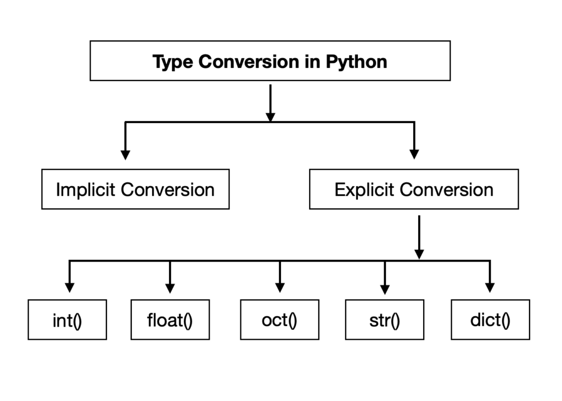
Type conversion functions

Slide 36
Implicit Type conversion functions
In Implicit type conversion of data types in Python, the Python interpreter automatically converts one data type to another without any user involvement.

Slide 37
Implicit Type conversion Example
x = 10
print("x is of type:",type(x))
y = 10.6
print("y is of type:",type(y))
z = x + y
print(z)
print("z is of type:",type(z))
Output
x is of type: <class 'int'>
y is of type: <class 'float'>
20.6
z is of type: <class 'float'>

Slide 38
Implicit Type conversion Example
As we can see the data type of ‘z’ got automatically
changed to the “float” type while one variable x is of
integer type while the other variable y is of float type.
The reason for the float value not being converted into an integer instead is due to type promotion that allows
performing operations by converting data into a
wider-sized data type without any loss of information.
This is a simple case of Implicit type conversion in
python.

Slide 39
Explicit Type conversion functions
In Explicit Type Conversion in Python, the data type is manually changed by the user as per their requirement. With explicit type conversion, there is a risk of data loss since we are forcing an expression to be changed in some specific data type. Various forms of explicit type
conversion are explained below:

Slide 40
Explicit Type conversion functions
int(a, base): This function converts any data type
to integer. ‘Base’ specifies the base in which string
is if the data type is a string.
2. float(): This function is used to convert any data
type to a floating-point number.
3. ord() : This function is used to convert a character
to integer.

Slide 41
Explicit Type conversion functions
4. hex() : This function is to convert integer to hexadecimal string.
5. oct() : This function is to convert integer to octal
string.
6. tuple() : This function is used to convert to a tuple.
7. set() : This function returns the type after
converting to set.

Slide 42
Explicit Type conversion functions
8. list() : This function is used to convert any data type to a list type.
9. dict() : This function is used to convert a tuple of order (key,value) into a dictionary.
10. str() : Used to convert integer into a string.

Slide 43
Explicit Type conversion functions
11. complex(real,imag) : This function converts real numbers to complex(real,imag) number.
12. chr(number): This function converts number to
its corresponding ASCII character.

Slide 44
Thanks for Your Attention

